Slide 1
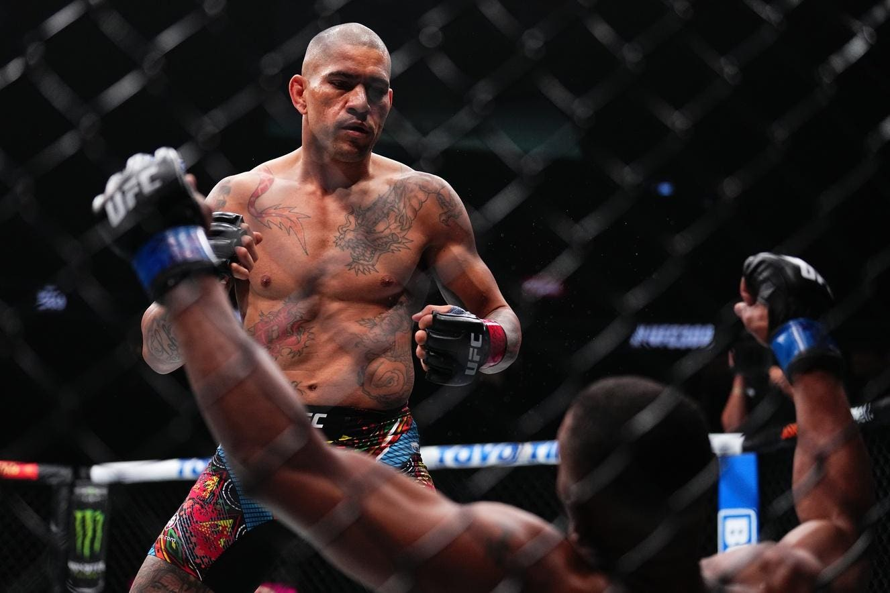
The Ultimate Fighting Championship (UFC) Through Dynamical Complex Networks Analysis
M. S. Castillo
Departamento de Física, Universidad Católica del Norte
msc796@alumnos.ucn.cl

Slide 2
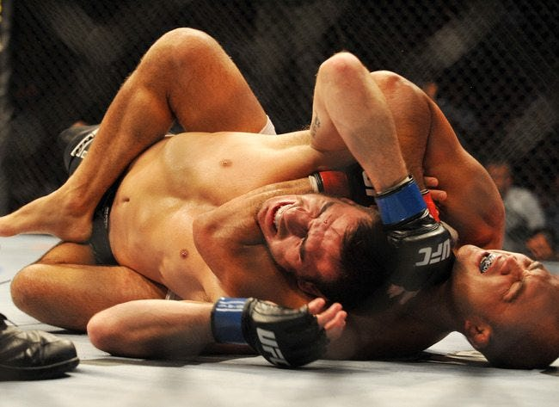
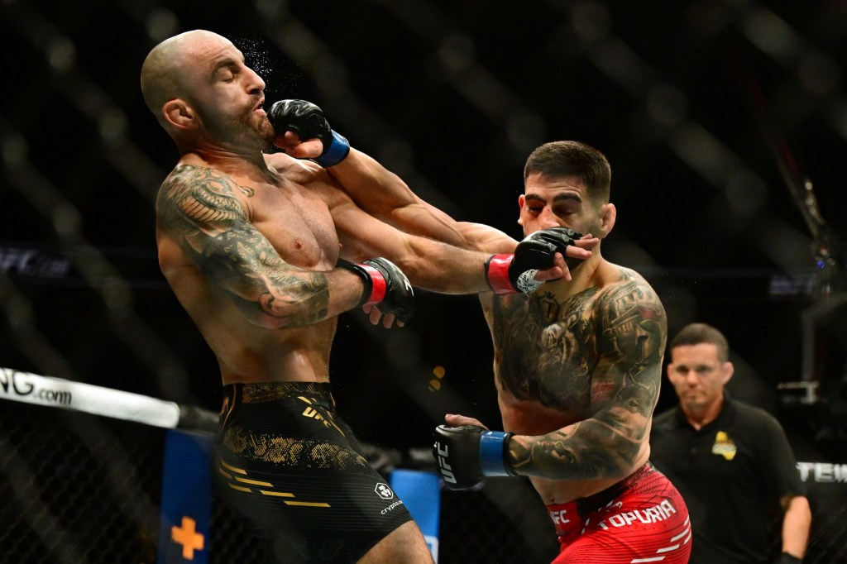
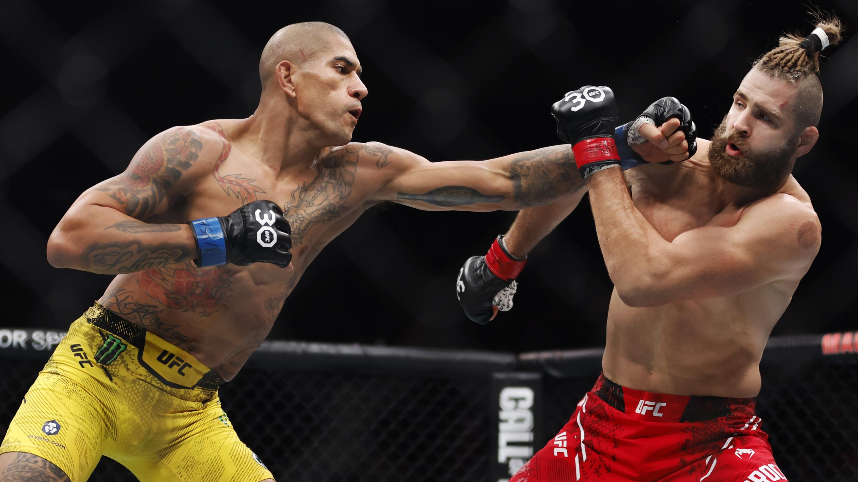
The UFC
Mixed martial arts (MMA). Two fighters face each other in an octagon.
Weight Classes
Fight Duration
Scoring
Legal Techniques
Fight Outcomes

Slide 3
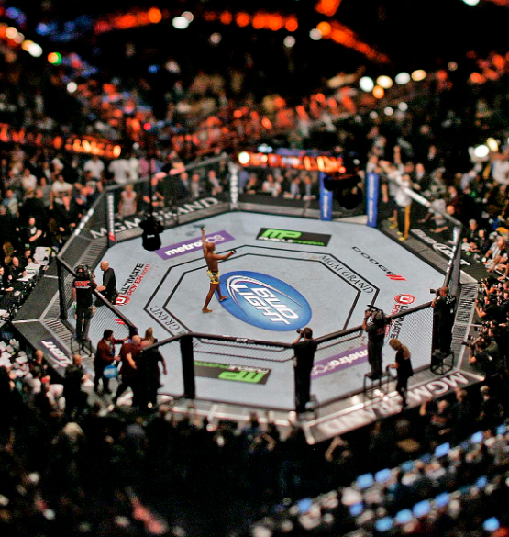
Motivations
Global Popularity and Reach (mainstream acceptance)
Economic Impact
Athletic Development and Recognition
Cultural Impact and Influence
We aim to:
Characterize the evolution of the sport using network metrics
Individualize fighters using these metrics

Slide 4
Methodology: network construction
Method 1:
we build networks based on the criteria of encounters: If fighter A had an encounter with fighter B, a link will form between these nodes.
Only based on the criteria of an encounter.
A
B

Slide 5
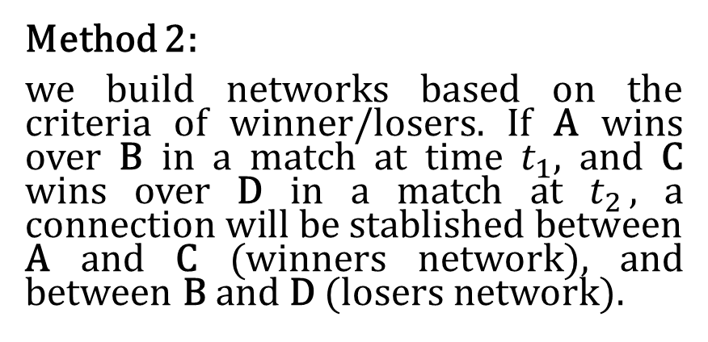
Methodology: network construction
Method 1:
we build networks based on the criteria of encounters: If fighter A had an encounter with fighter B, a link will form between these nodes.
A wins over B
A
B
Winners network
Method 2:
we build networks based on the criteria of winner/losers. If A wins over B in a match at time $t_{1}$, and C wins over D in a match at $t_{2}$, a connection will be stablished between A and C (winners network), and between B and D (losers network).
A
C
A wins over B
C wins over D
B
D
Losers network

Slide 6
Methodology: network construction
Method 1:
we build networks based on the criteria of encounters: If fighter A had an encounter with fighter B, a link will form between these nodes.
Only based on the criteria of an encounter.
A
B
The studied data is the UFC's historical fight record, spanning from 1993 to 2021.
https://www.kaggle.com/datasets/rajeevw/ufcdata
Winners network
Method 2:
we build networks based on the criteria of winner/losers. If A wins over B in a match at time $t_{1}$, and C wins over D in a match at $t_{2}$, a connection will be stablished between A and C (winners network), and between B and D (losers network).
A
C
A wins over B
C wins over D
B
C
Losers network

Slide 7
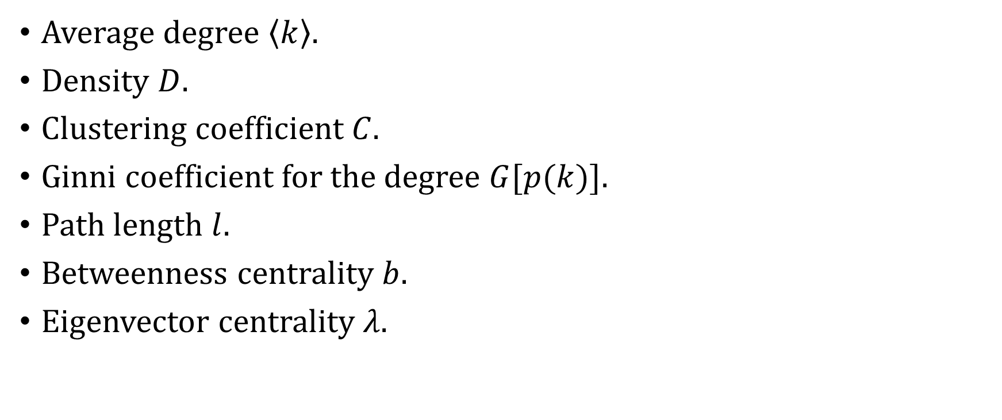
Methodology: metrics
Average degree $\left\langle k\right\rangle$.
Density $D$.
Clustering coefficient $C.$
Ginni coefficient for the degree $G[p(k)]$.
Path length $l.$
Betweenness centrality $b$.
Eigenvector centrality $λ$.

Slide 8
Methodology: metrics
Average degree $\left\langle k\right\rangle$.
Density $D$.
Clustering coefficient $C.$
Ginni coefficient for the degree $G[p(k)]$.
Path length $l.$
Betweenness centrality $b$.
Eigenvector centrality $λ$.
We evaluated the statistical properties of the data and the conformed network metrics in 2-year windows, with 1-month offset.

Slide 9
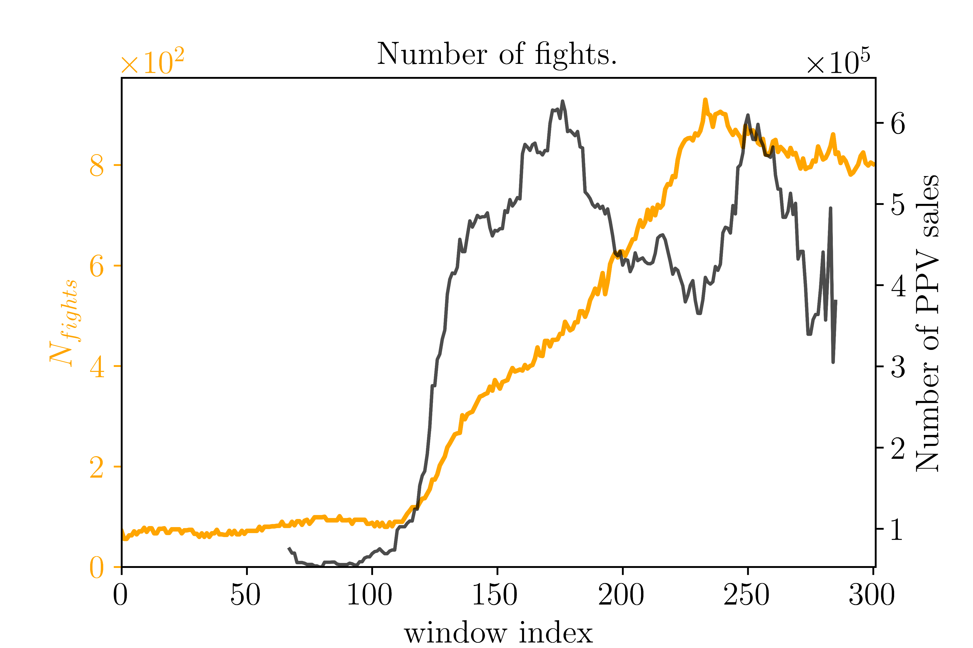
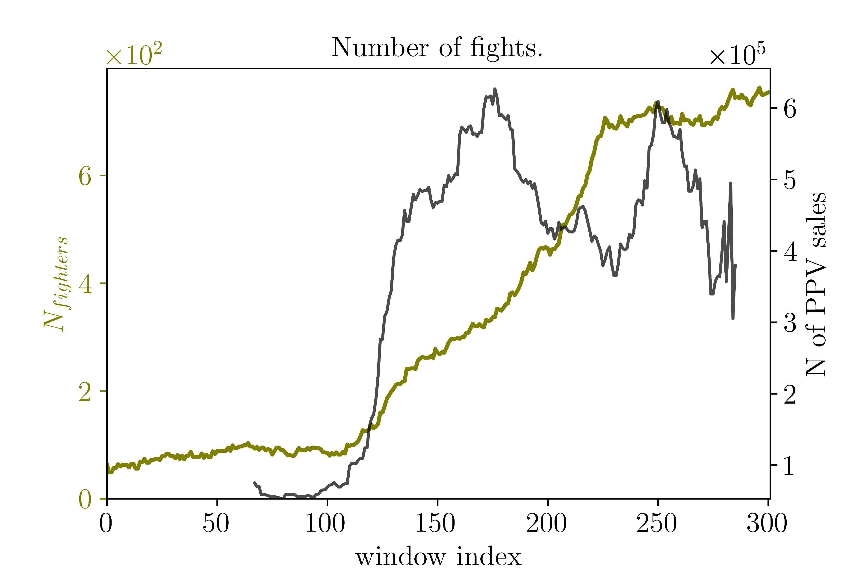
Results: statistical analysis
PPV: Pay per view events -> Measure of popularity

Slide 10
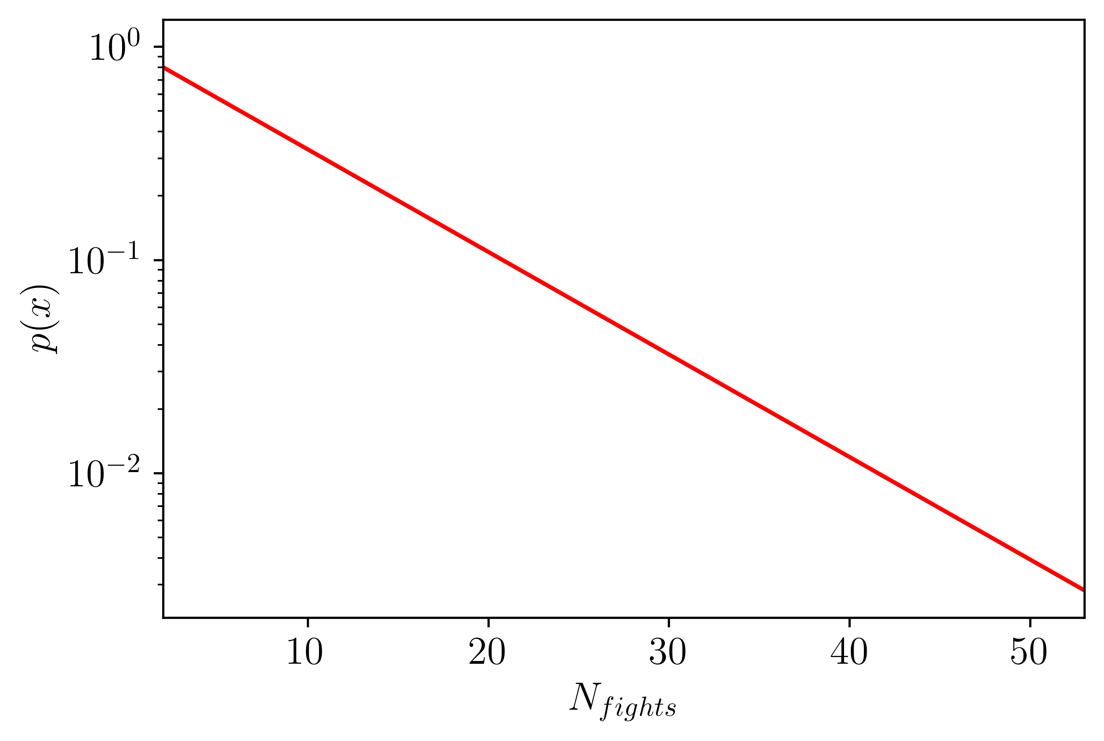
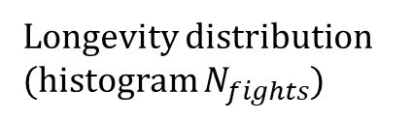
Results: statistical analysis
Longevity distribution
(histogram $N_{fights}$)

Slide 11
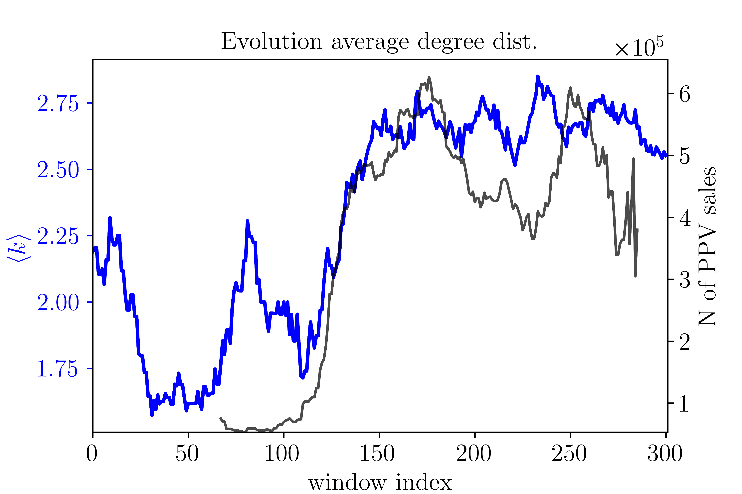
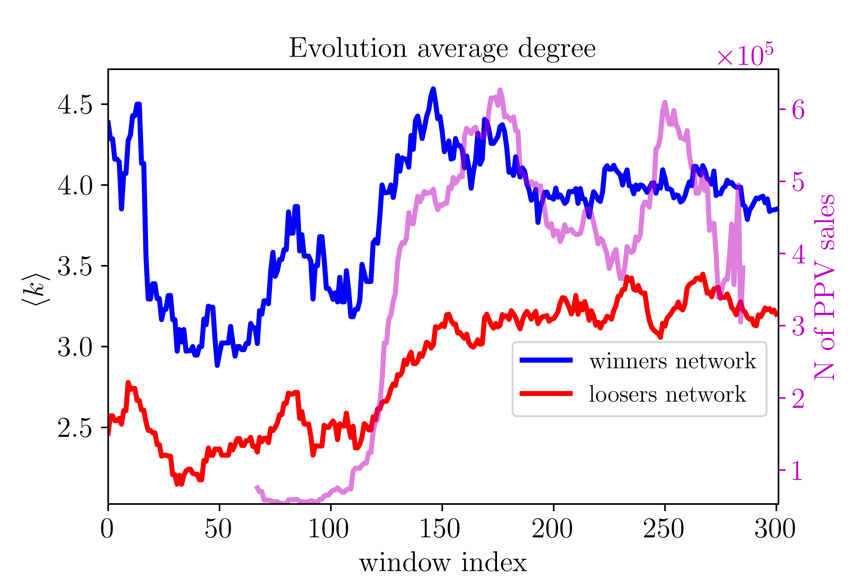
Results: complex networks
Encounter criteria – winners/loser networks

Slide 12
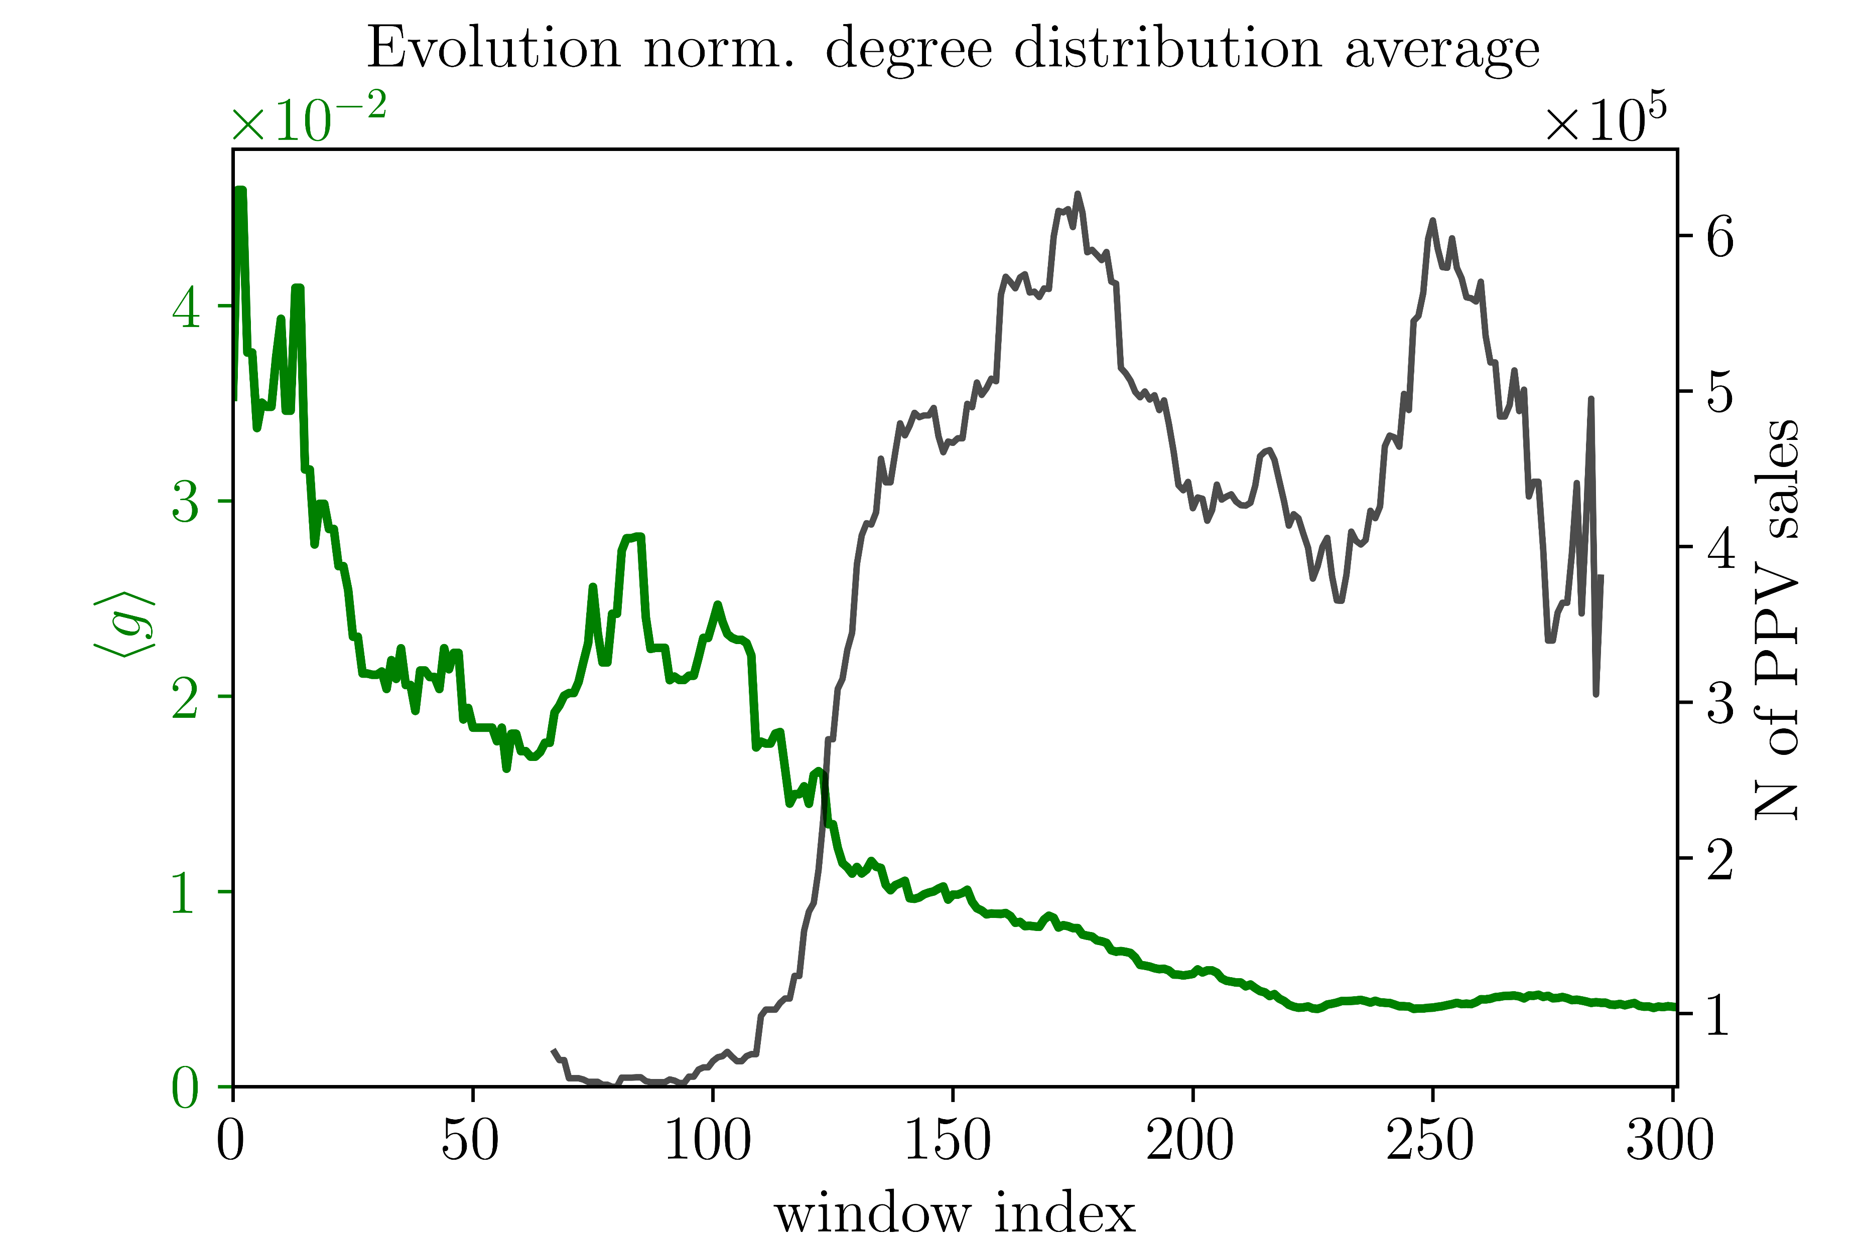
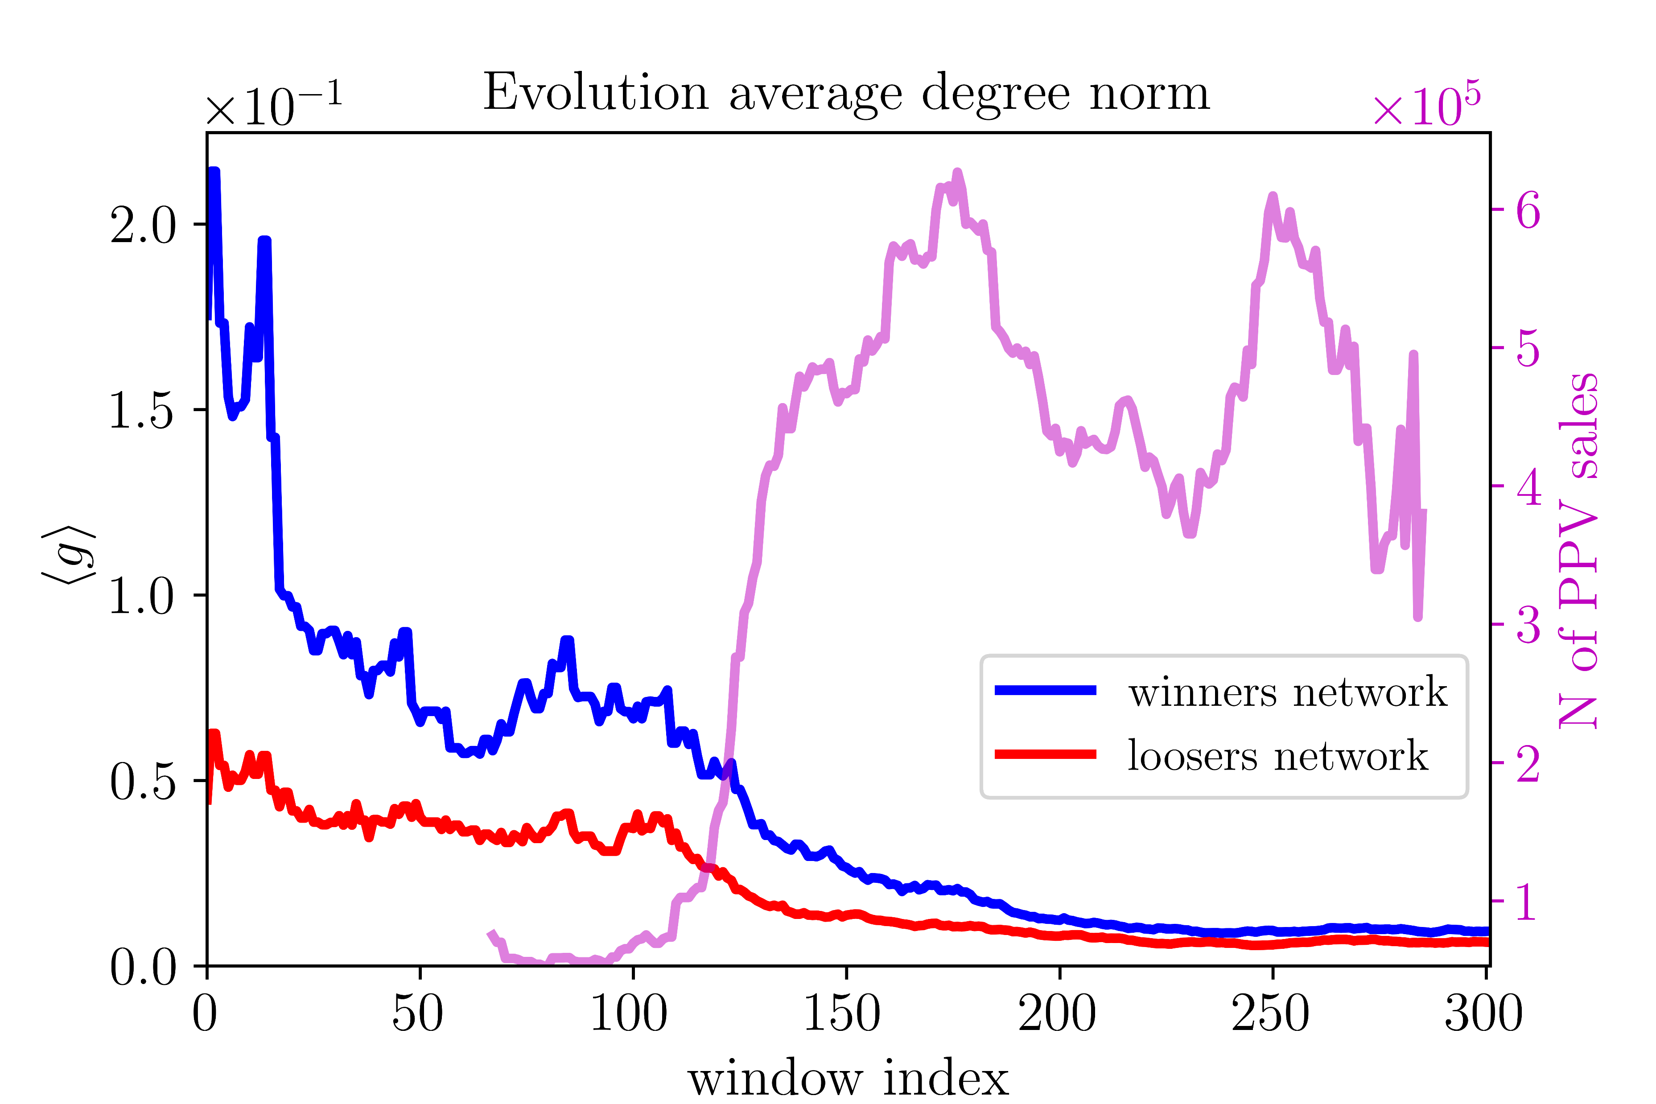
Results: complex networks
Encounter criteria – winners/loser networks

Slide 13
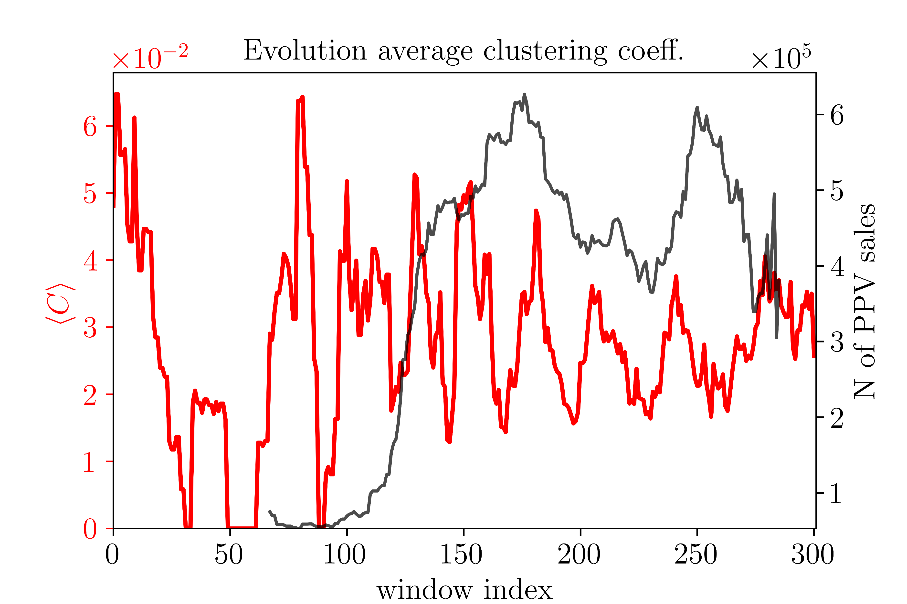
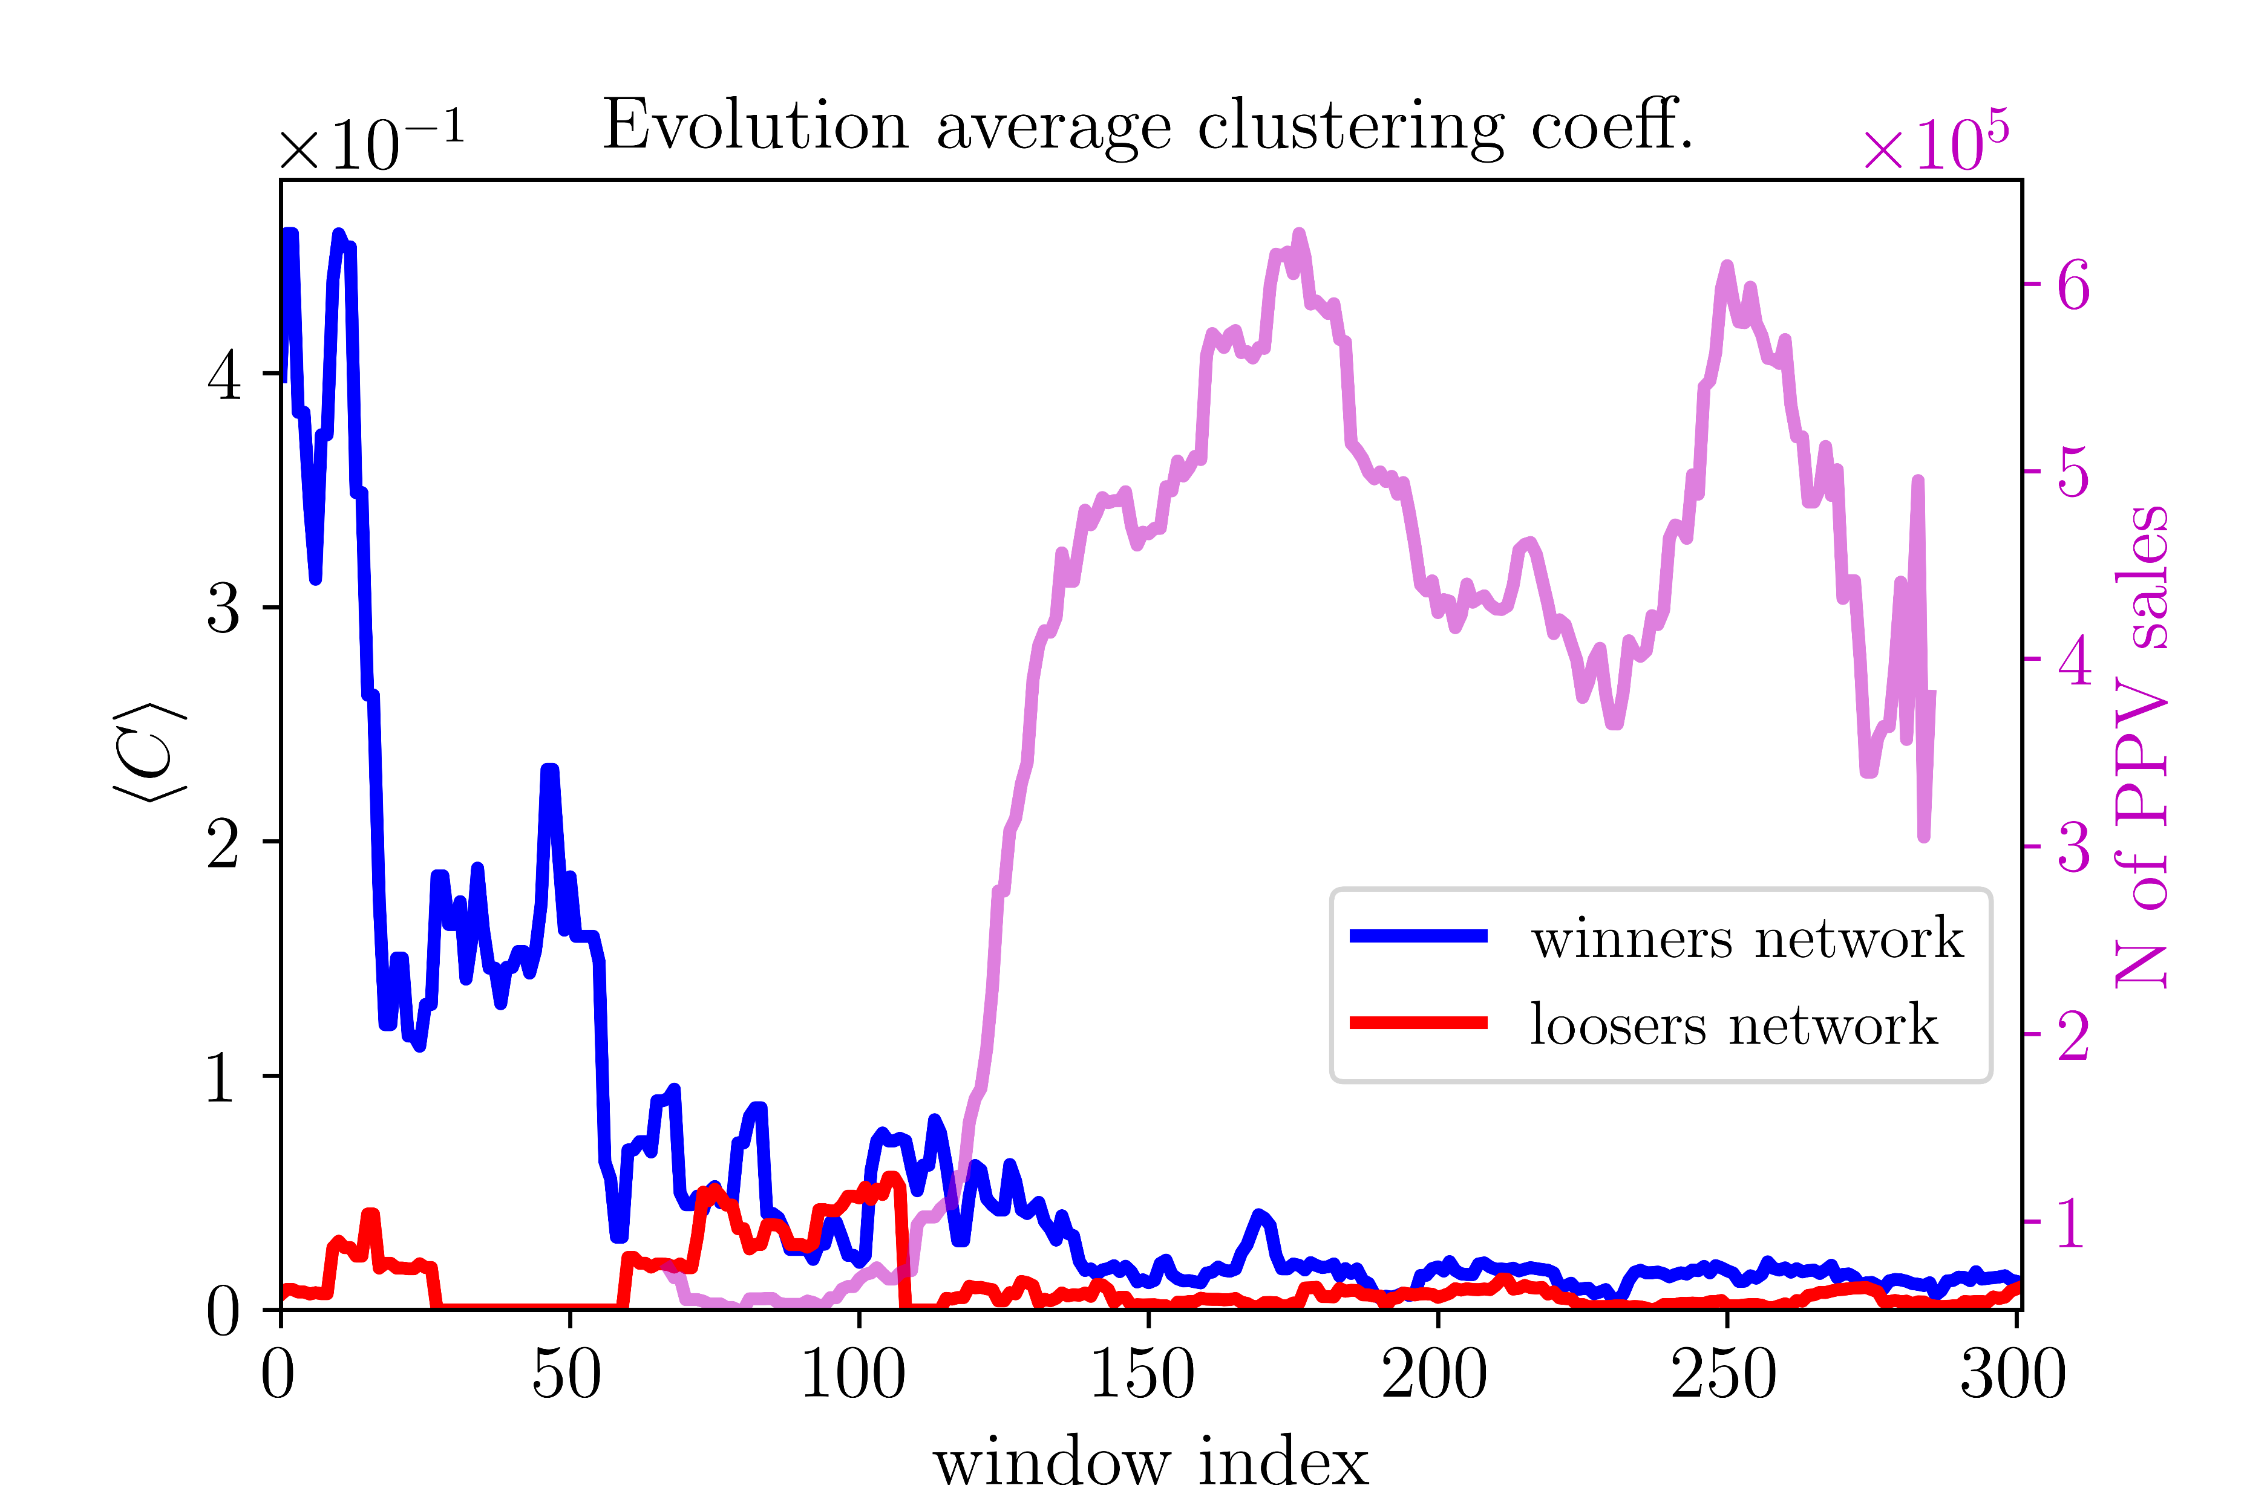
Results: complex networks
Encounter criteria – winners/loser networks

Slide 14
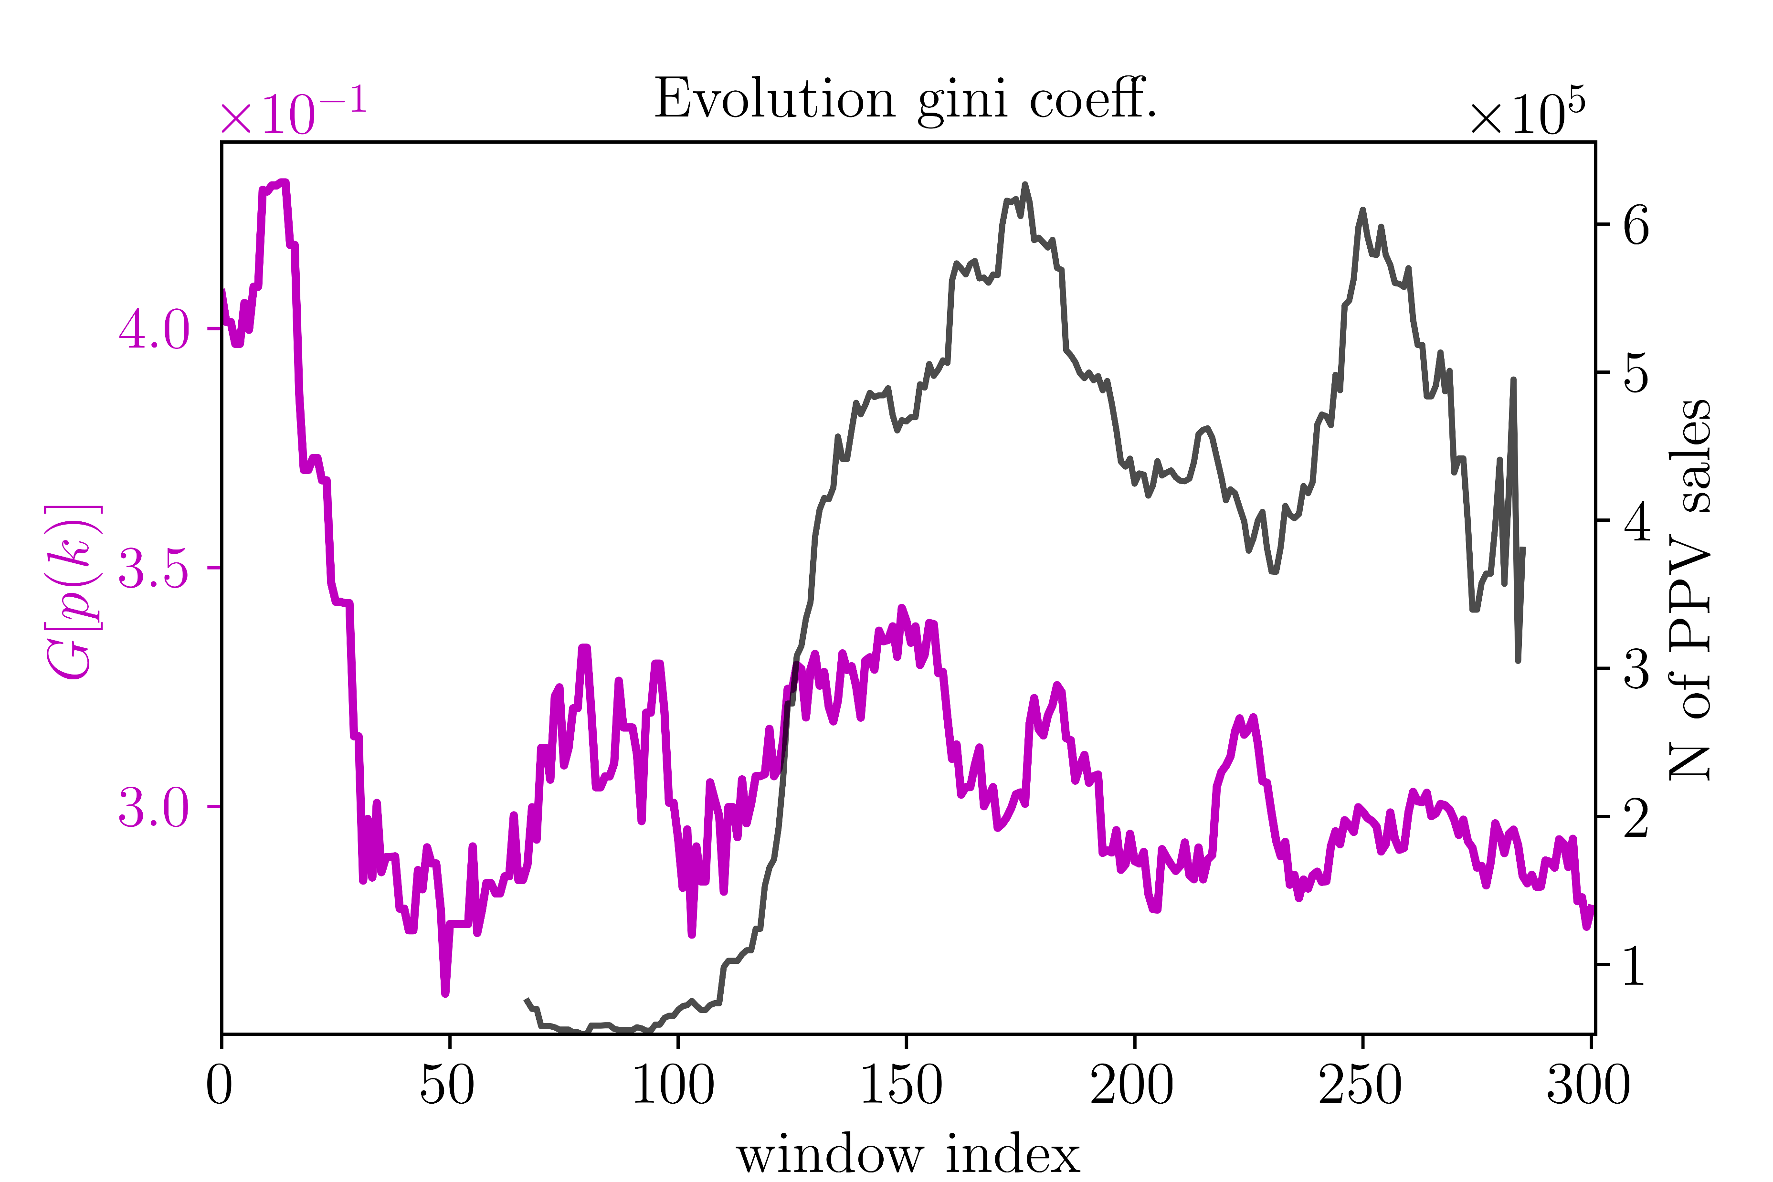
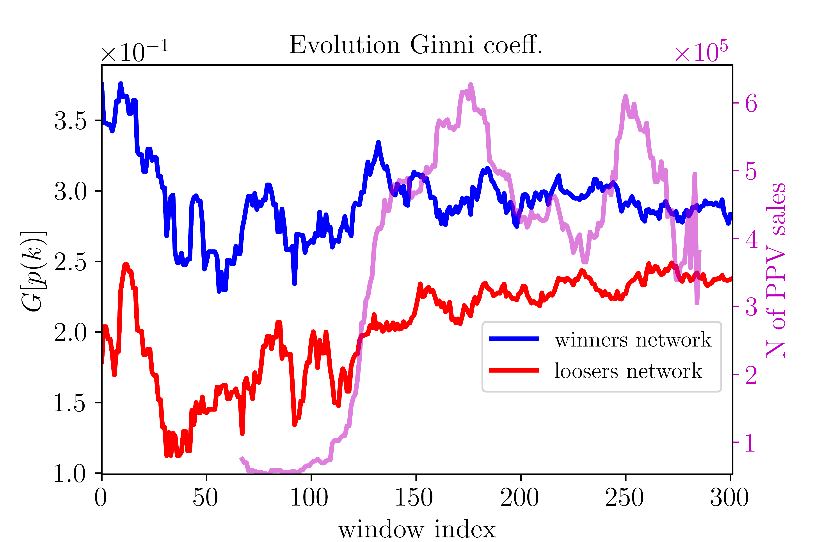
Results: complex networks
Encounter criteria – winners/loser networks

Slide 15
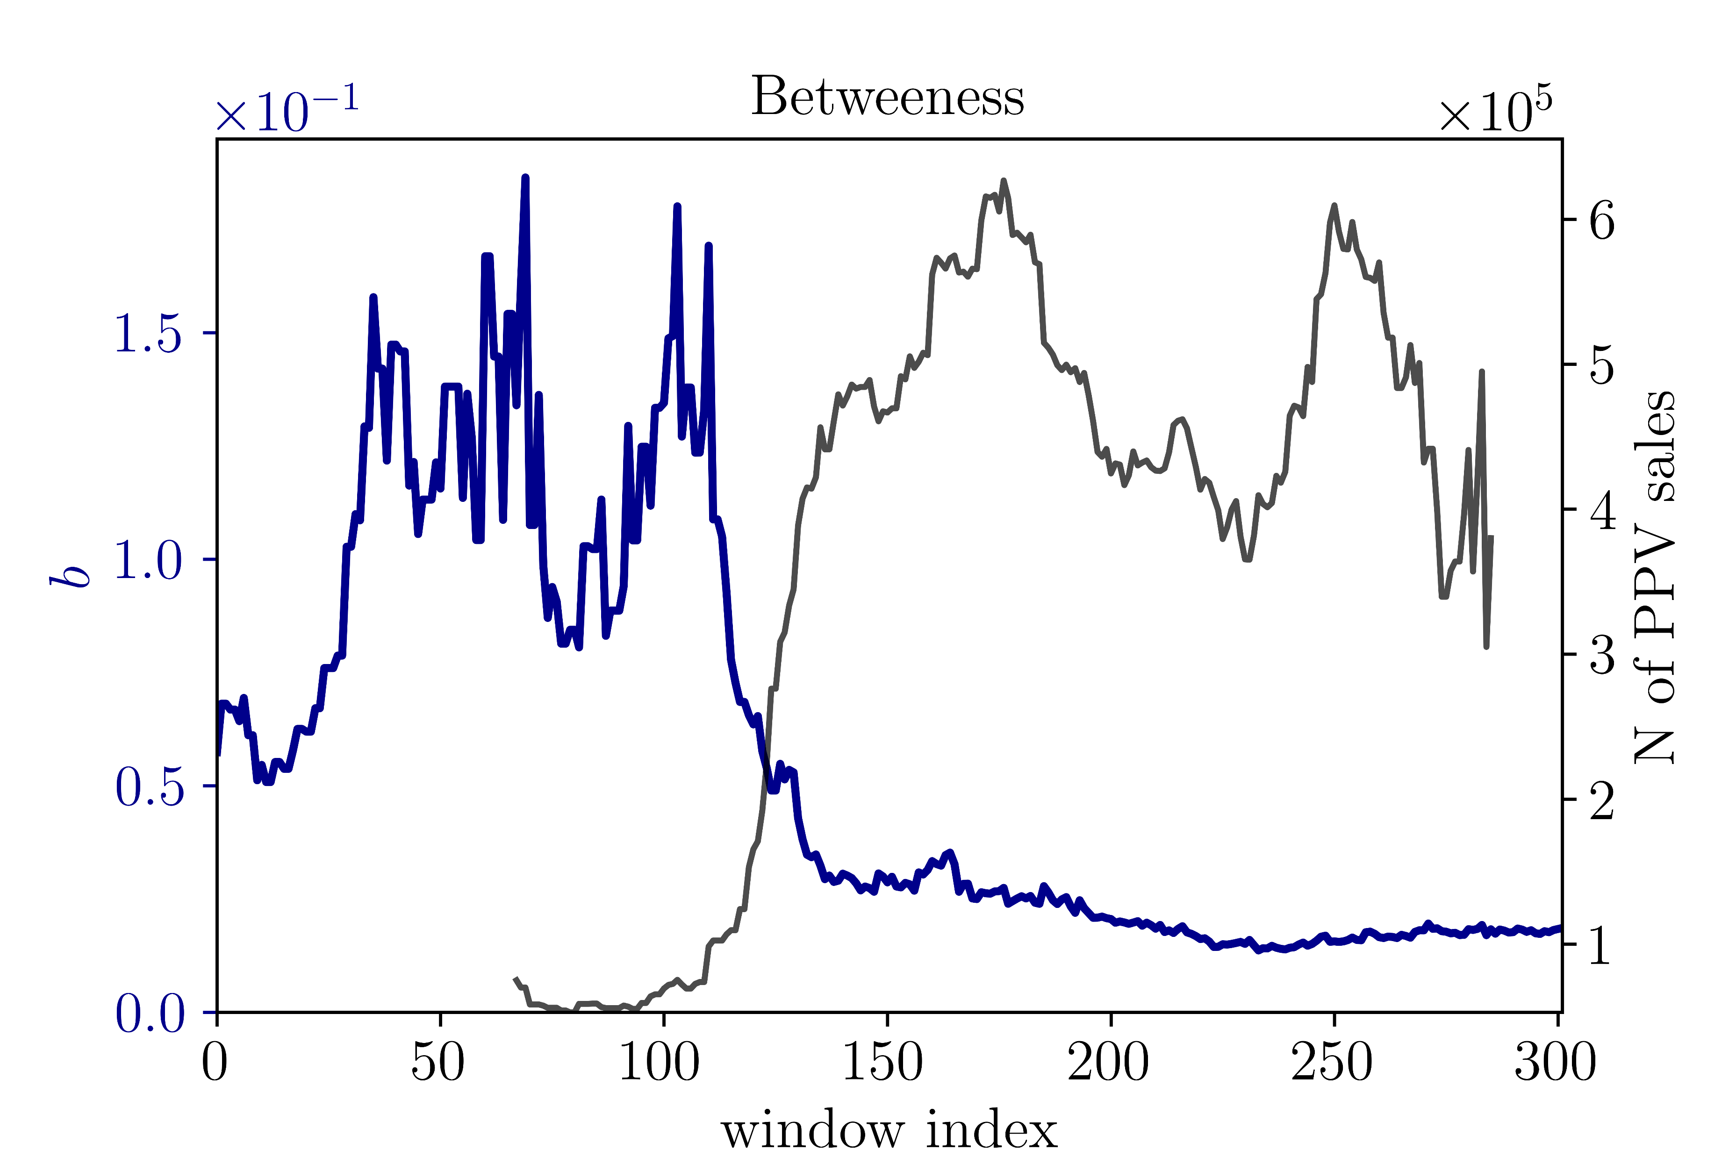
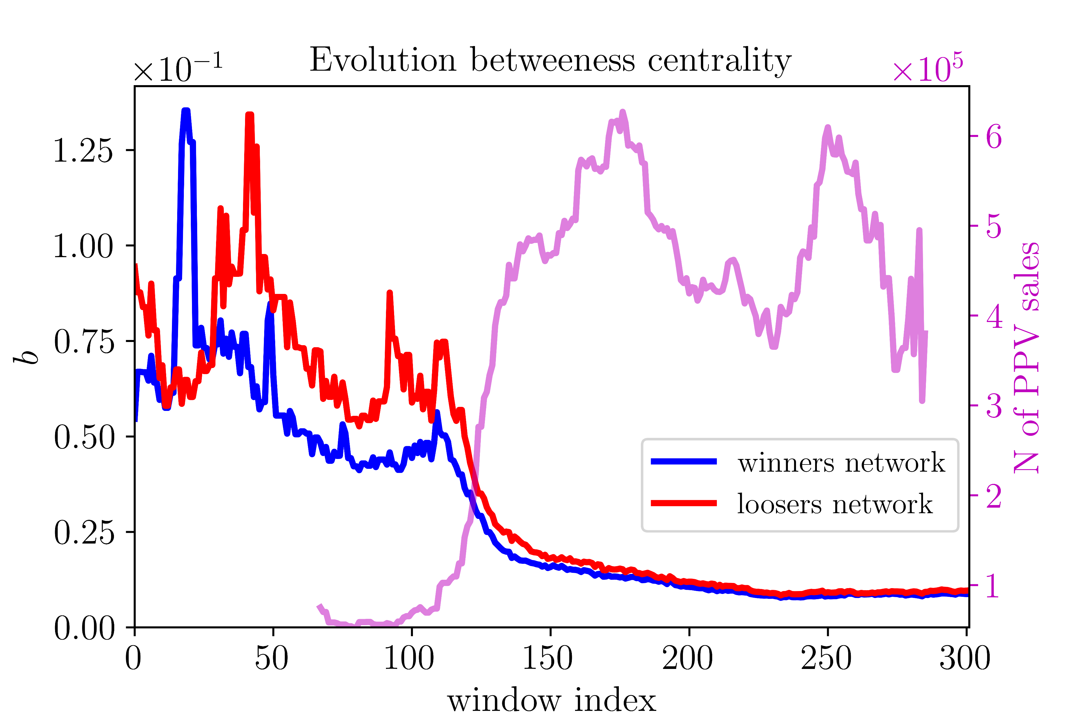
Results: complex networks
Encounter criteria – winners/loser networks

Slide 16
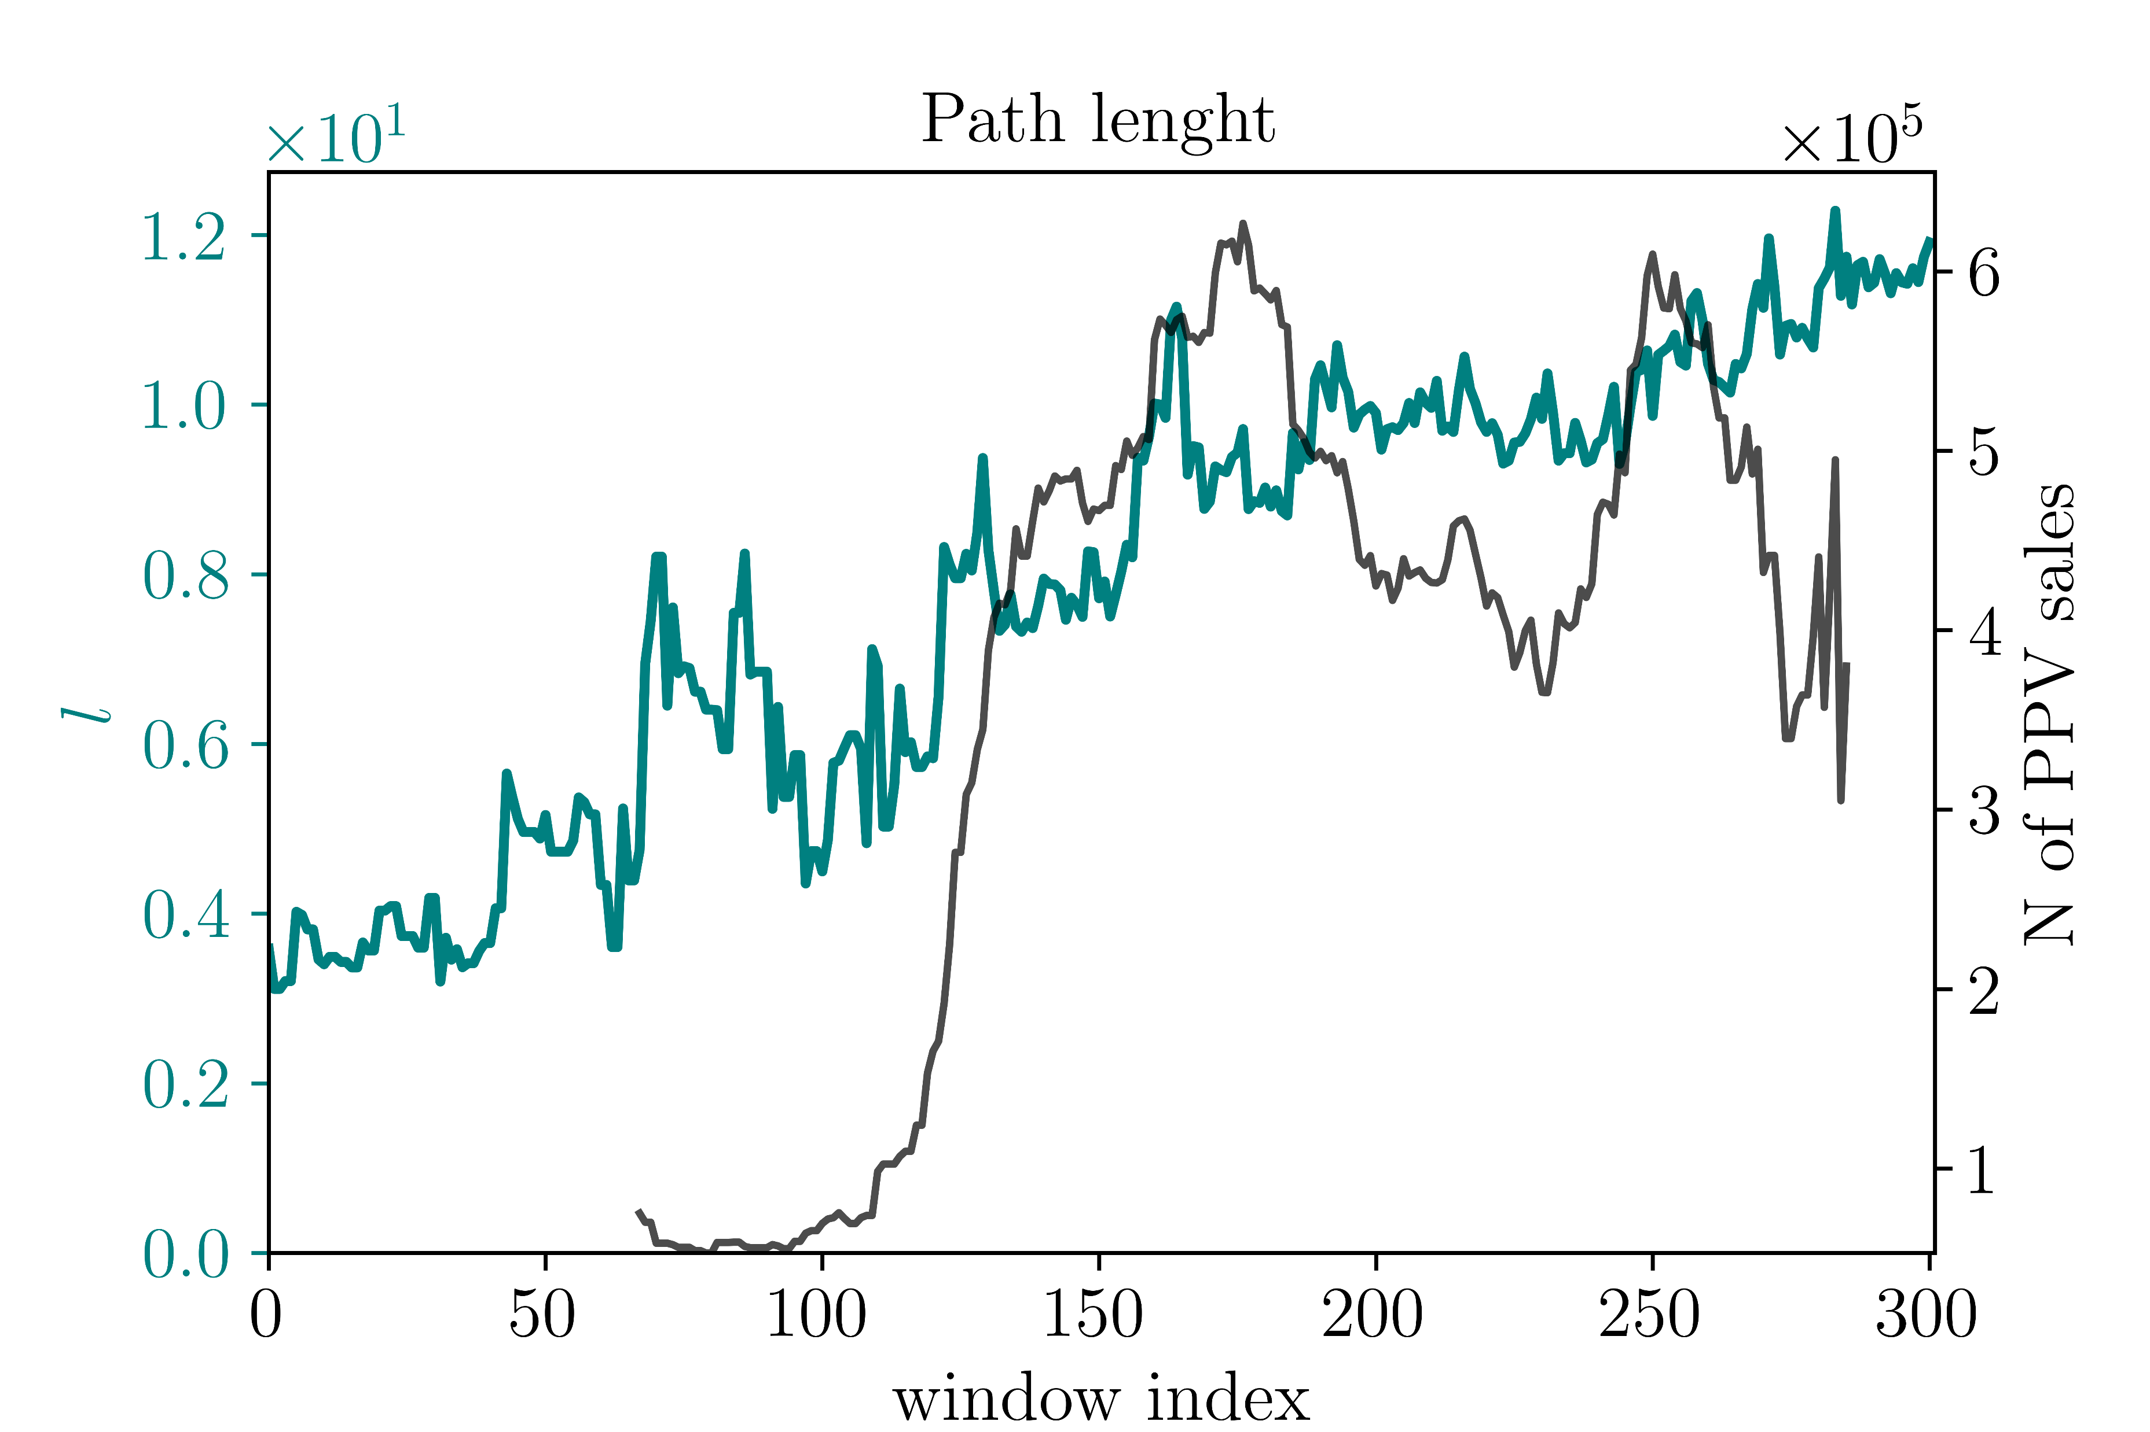
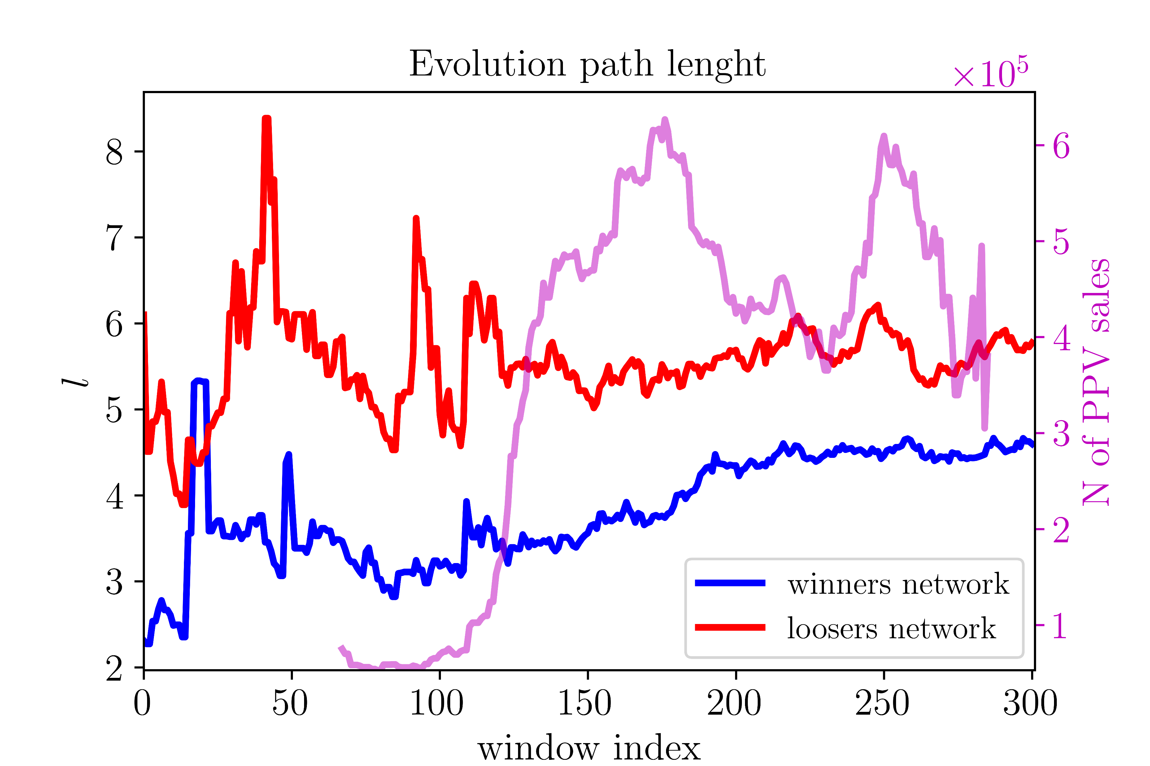
Results: complex networks
Encounter criteria – winners/loser networks

Slide 17
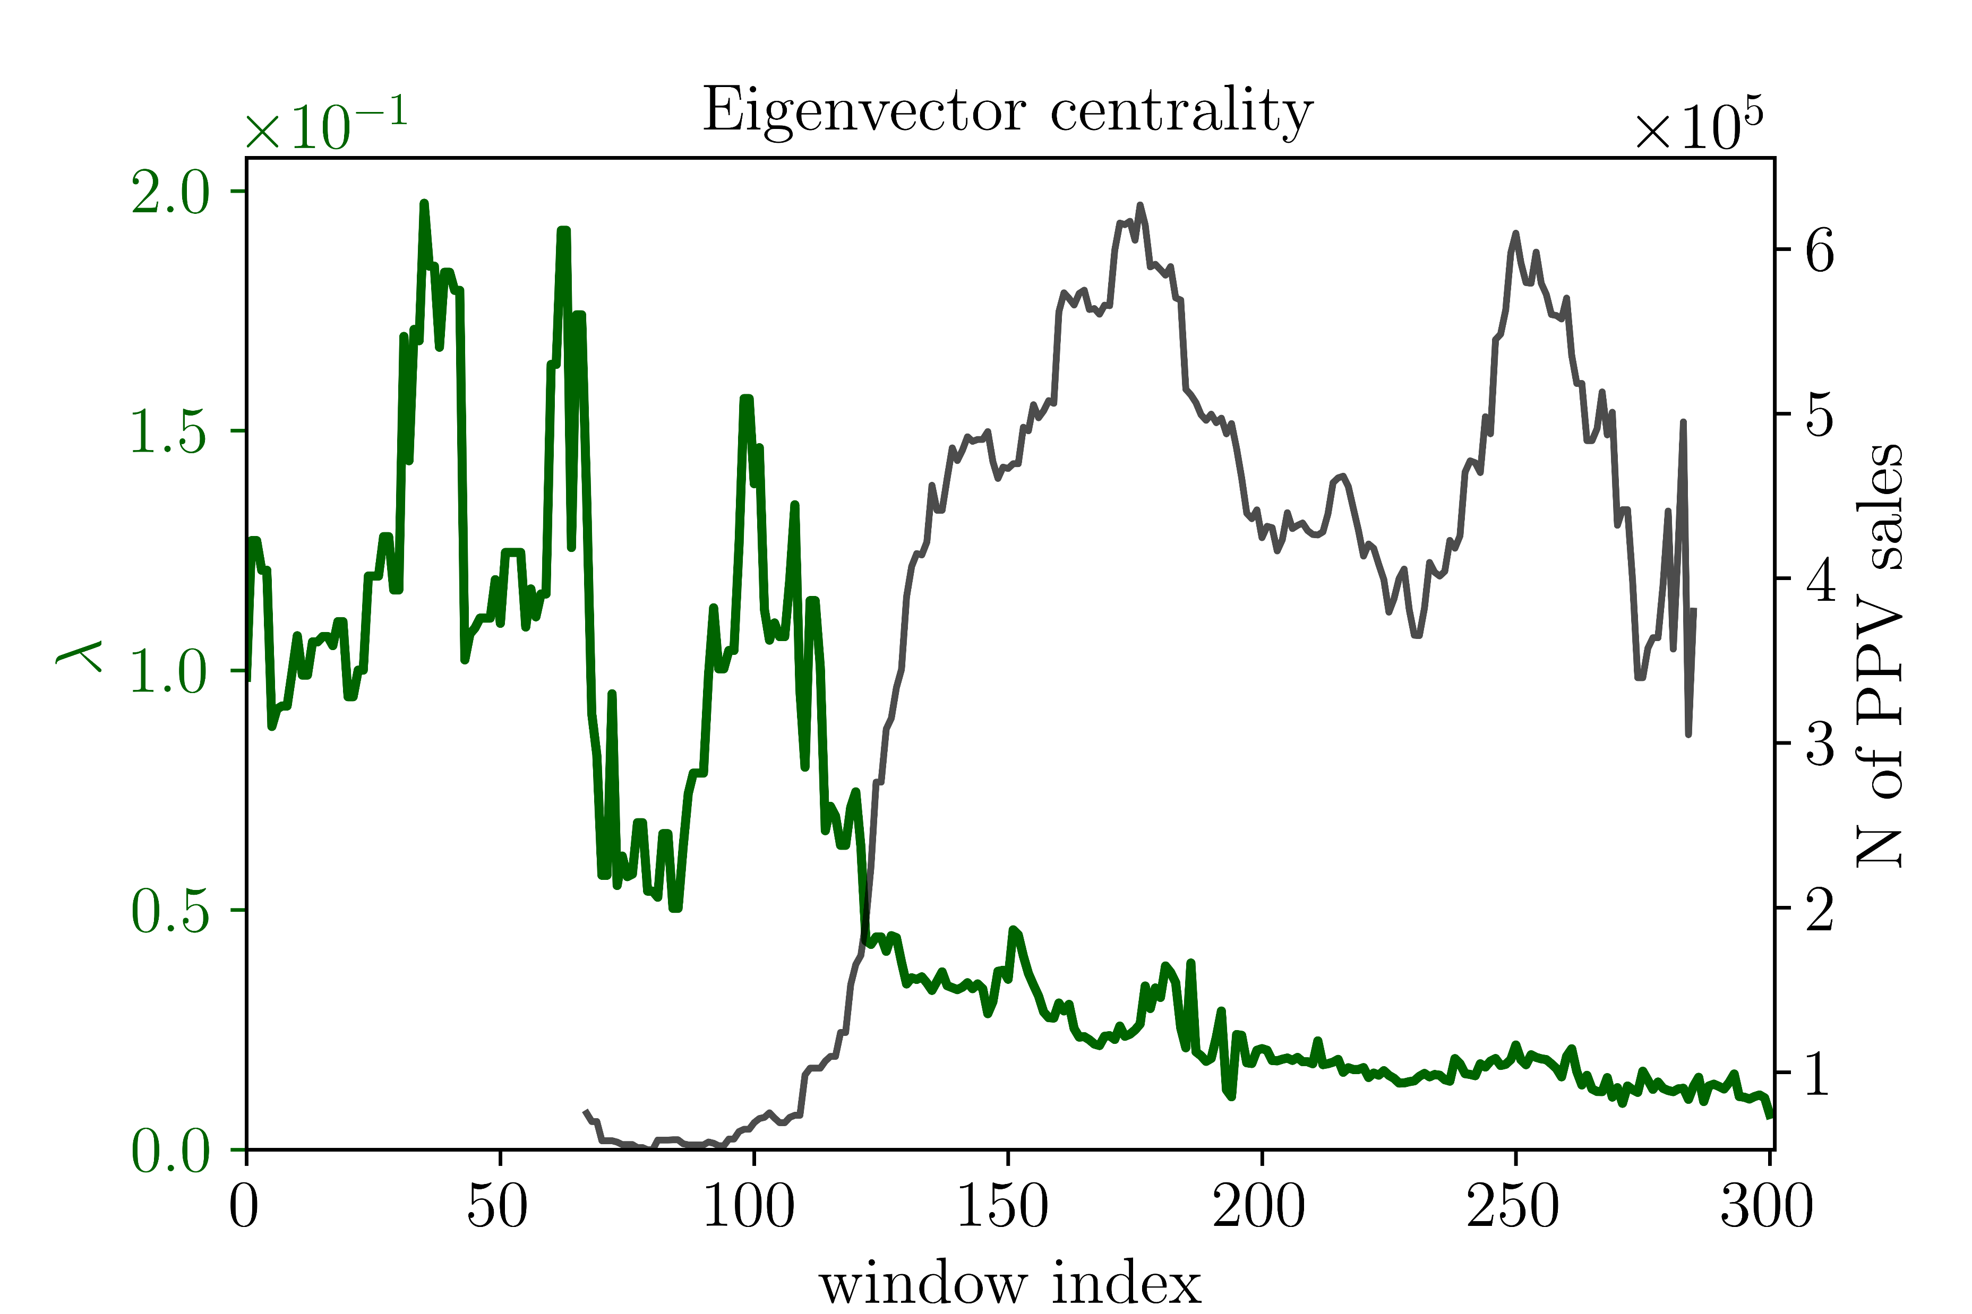
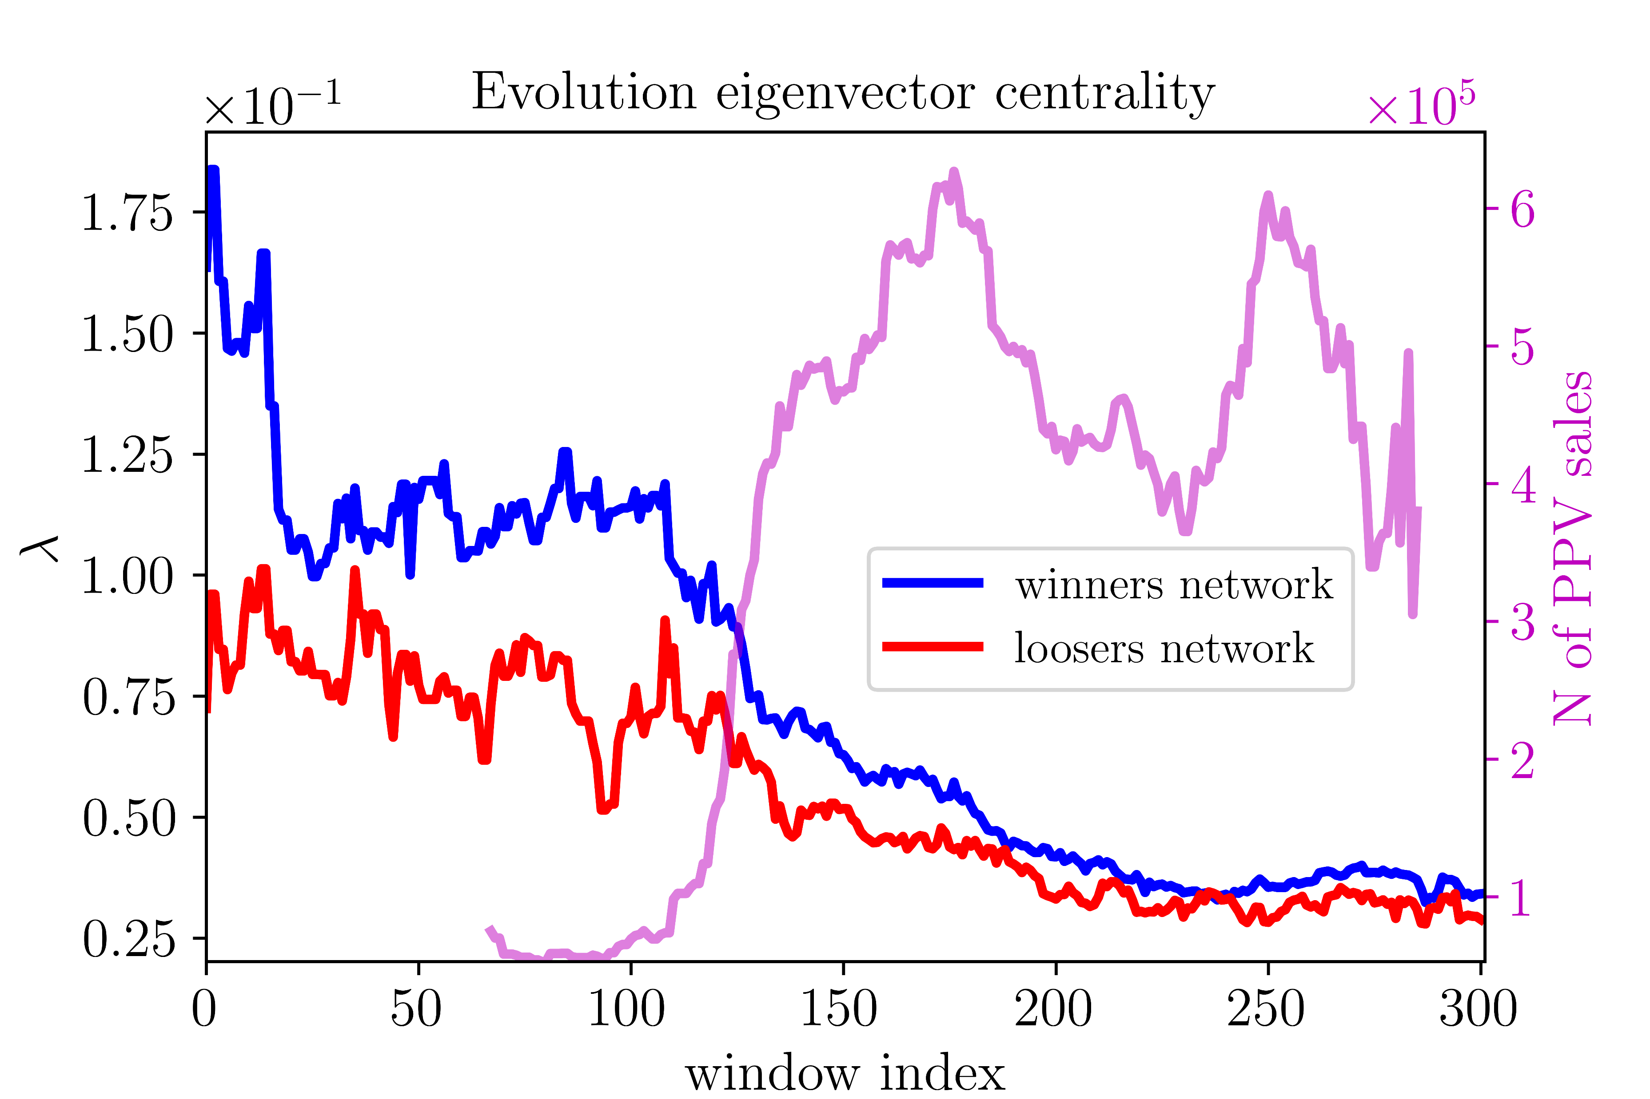
Results: complex networks
Encounter criteria – winners/loser networks

Slide 18
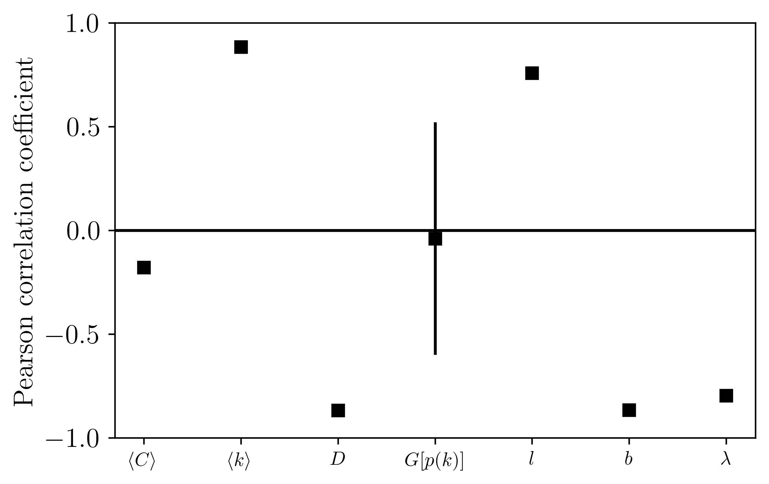
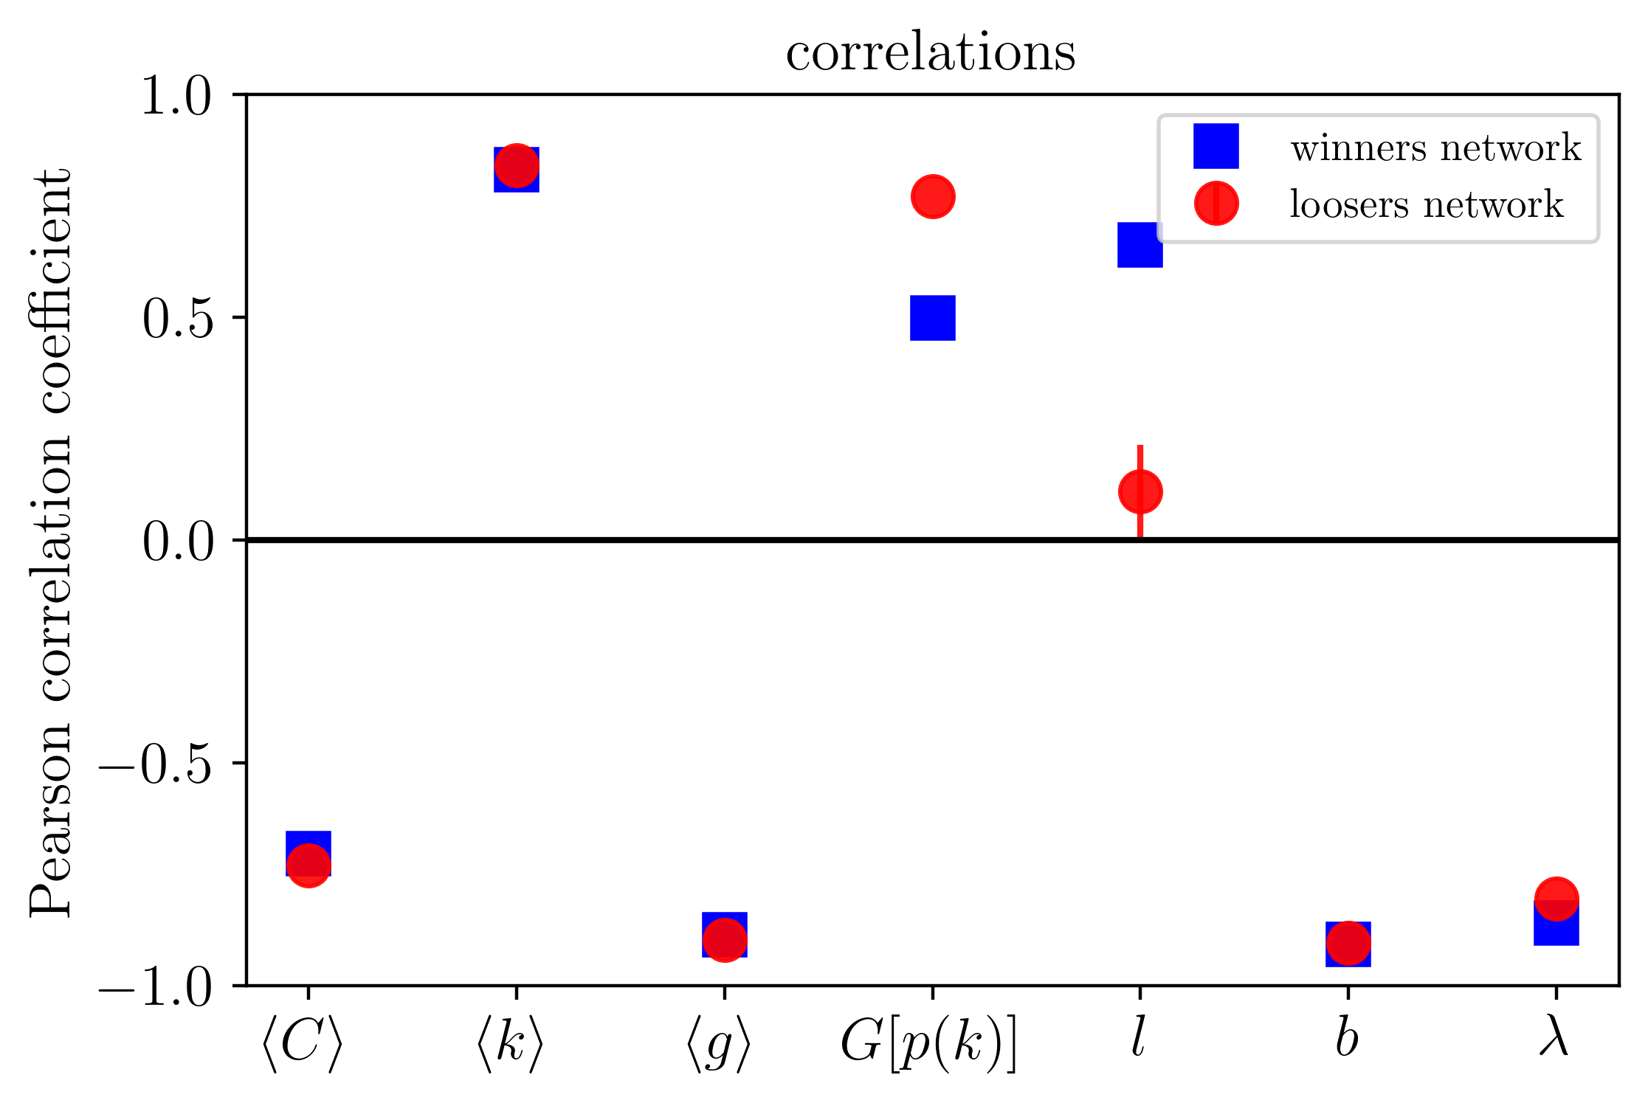
Results: complex networks
Encounter criteria – winners/loser networks

Slide 19
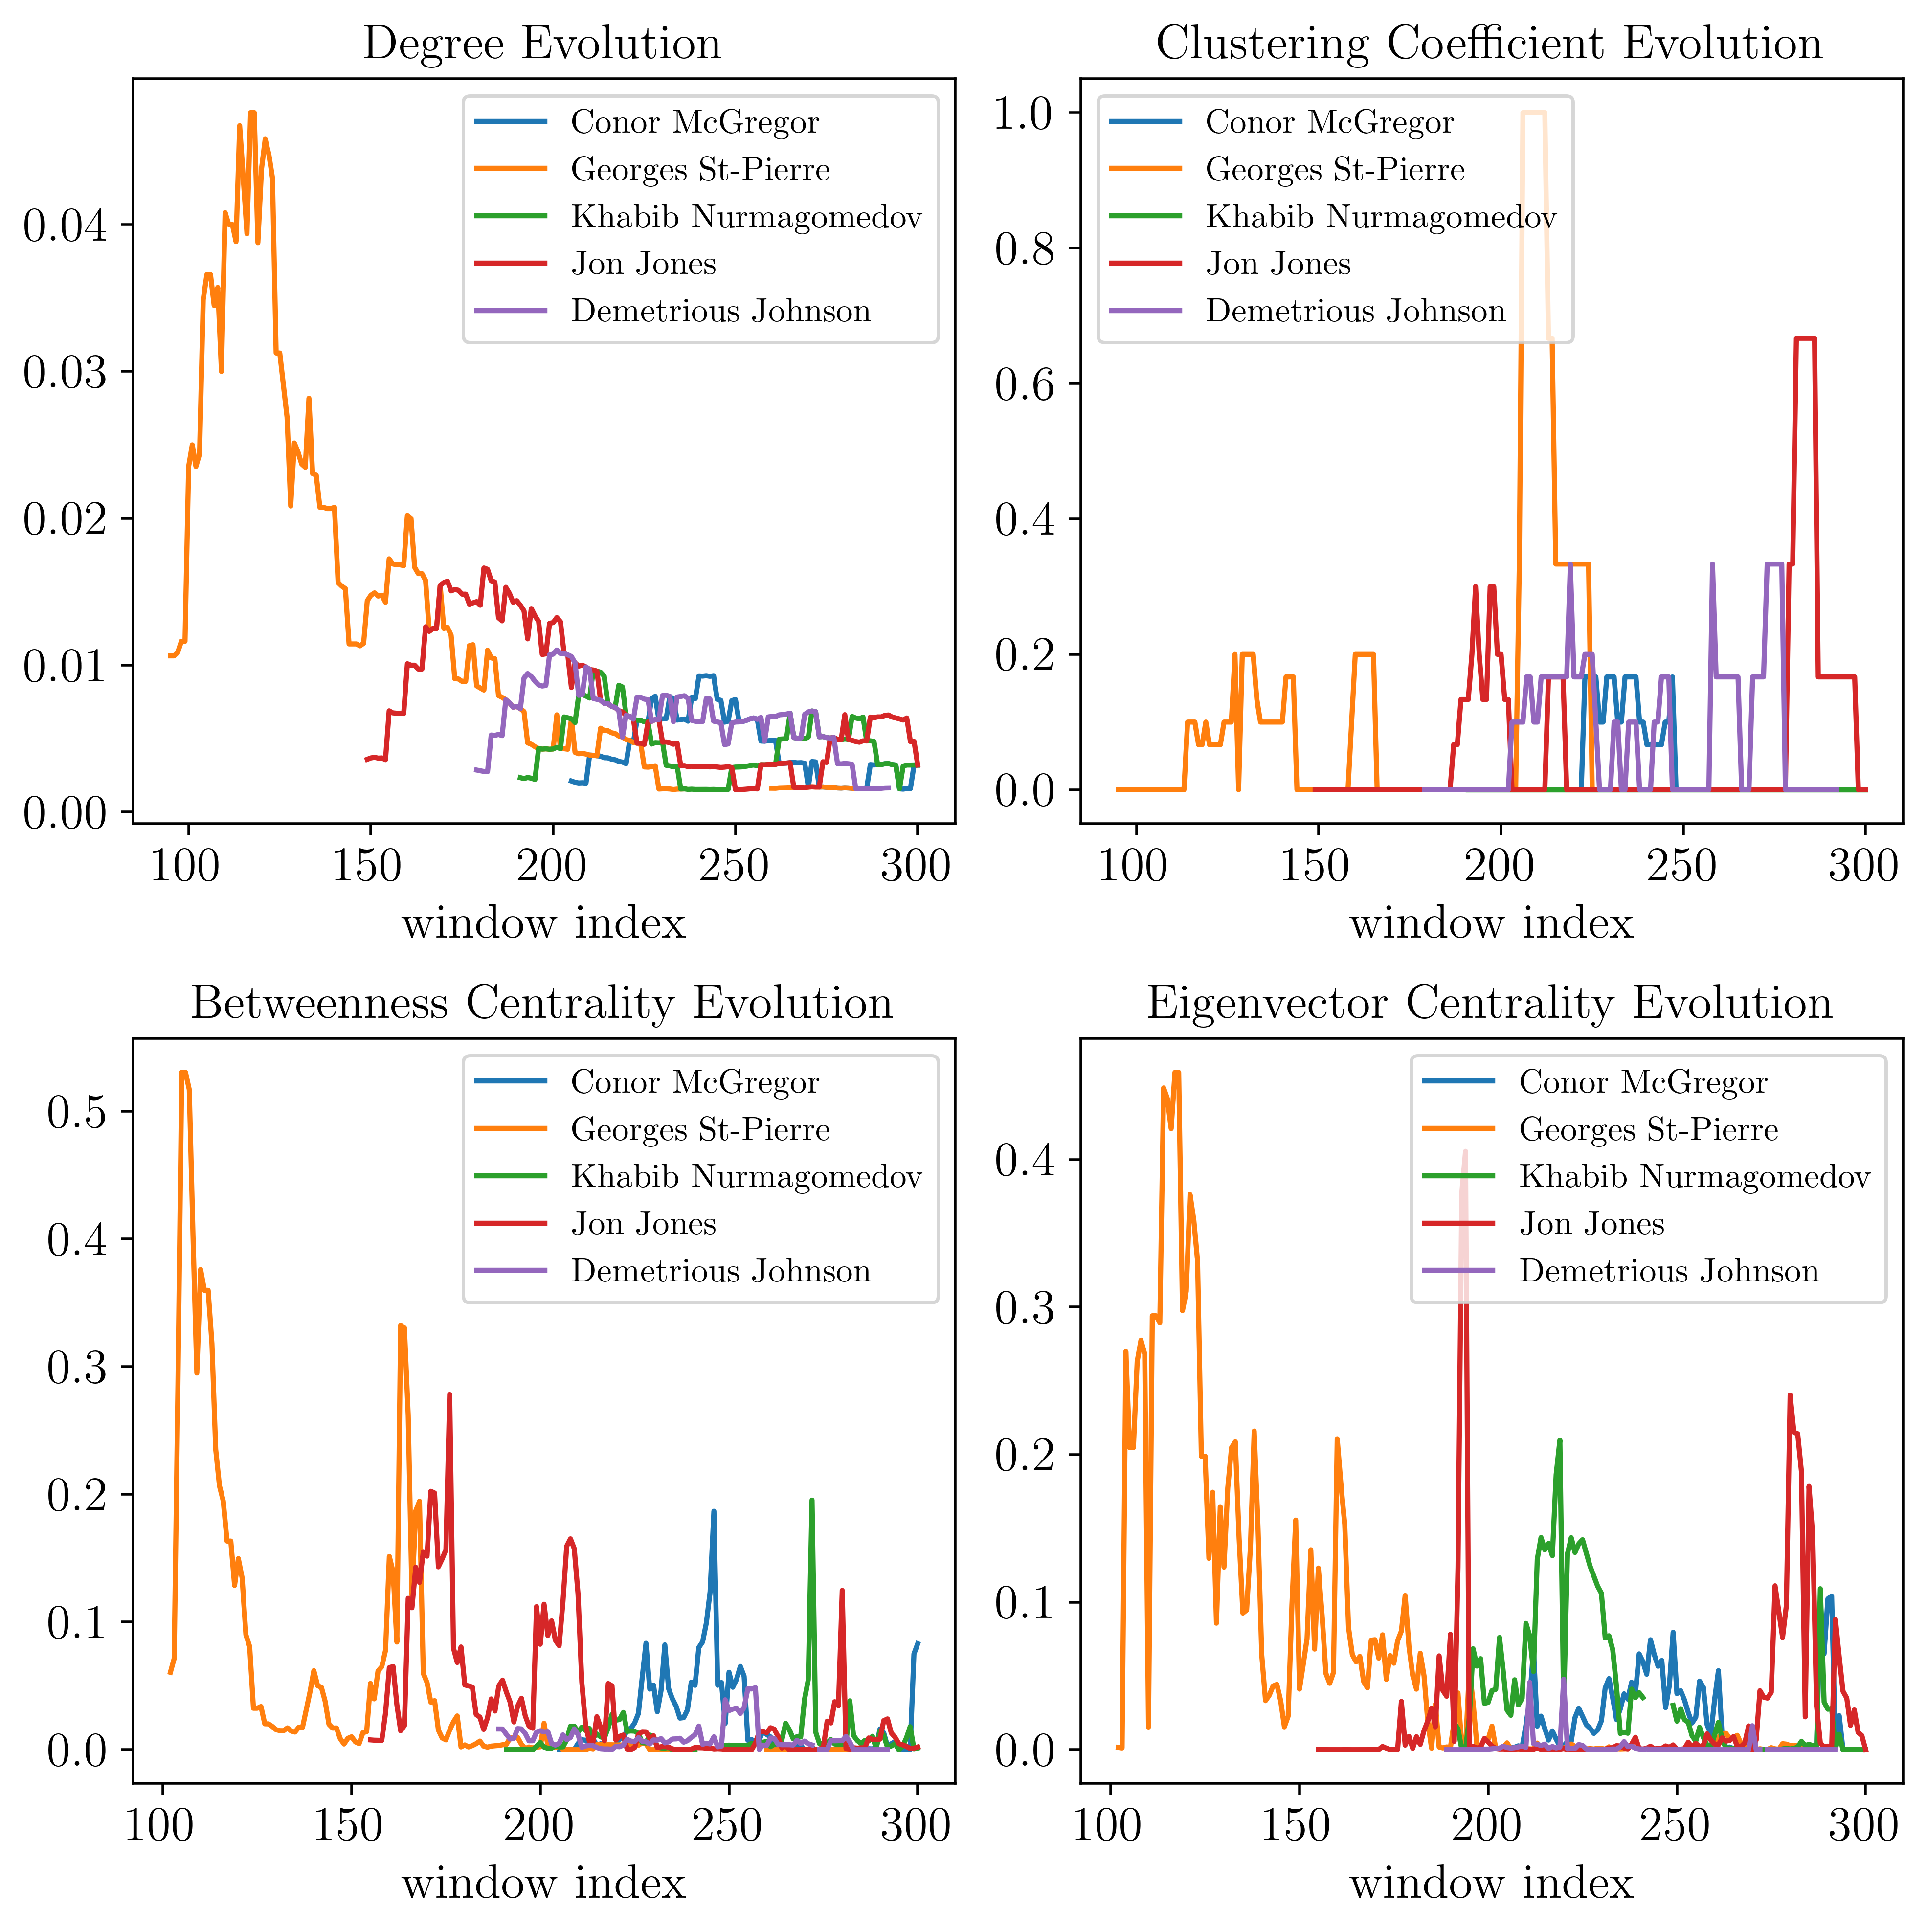

Slide 20
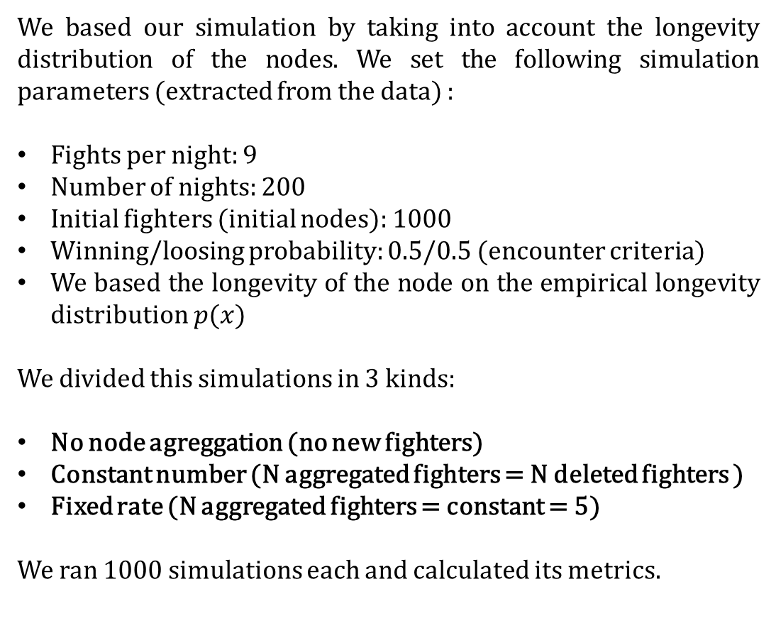
Simulation
We based our simulation by taking into account the longevity distribution of the nodes. We set the following simulation parameters (extracted from the data) :
Fights per night: 9
Number of nights: 200
Initial fighters (initial nodes): 1000
Winning/loosing probability: 0.5/0.5 (encounter criteria)
We based the longevity of the node on the empirical longevity distribution $p(x)$
We divided this simulations in 3 kinds:
No node agreggation (no new fighters)
Constant number (N aggregated fighters = N deleted fighters )
Fixed rate (N aggregated fighters = constant = 5)
We ran 1000 simulations each and calculated its metrics.

Slide 21
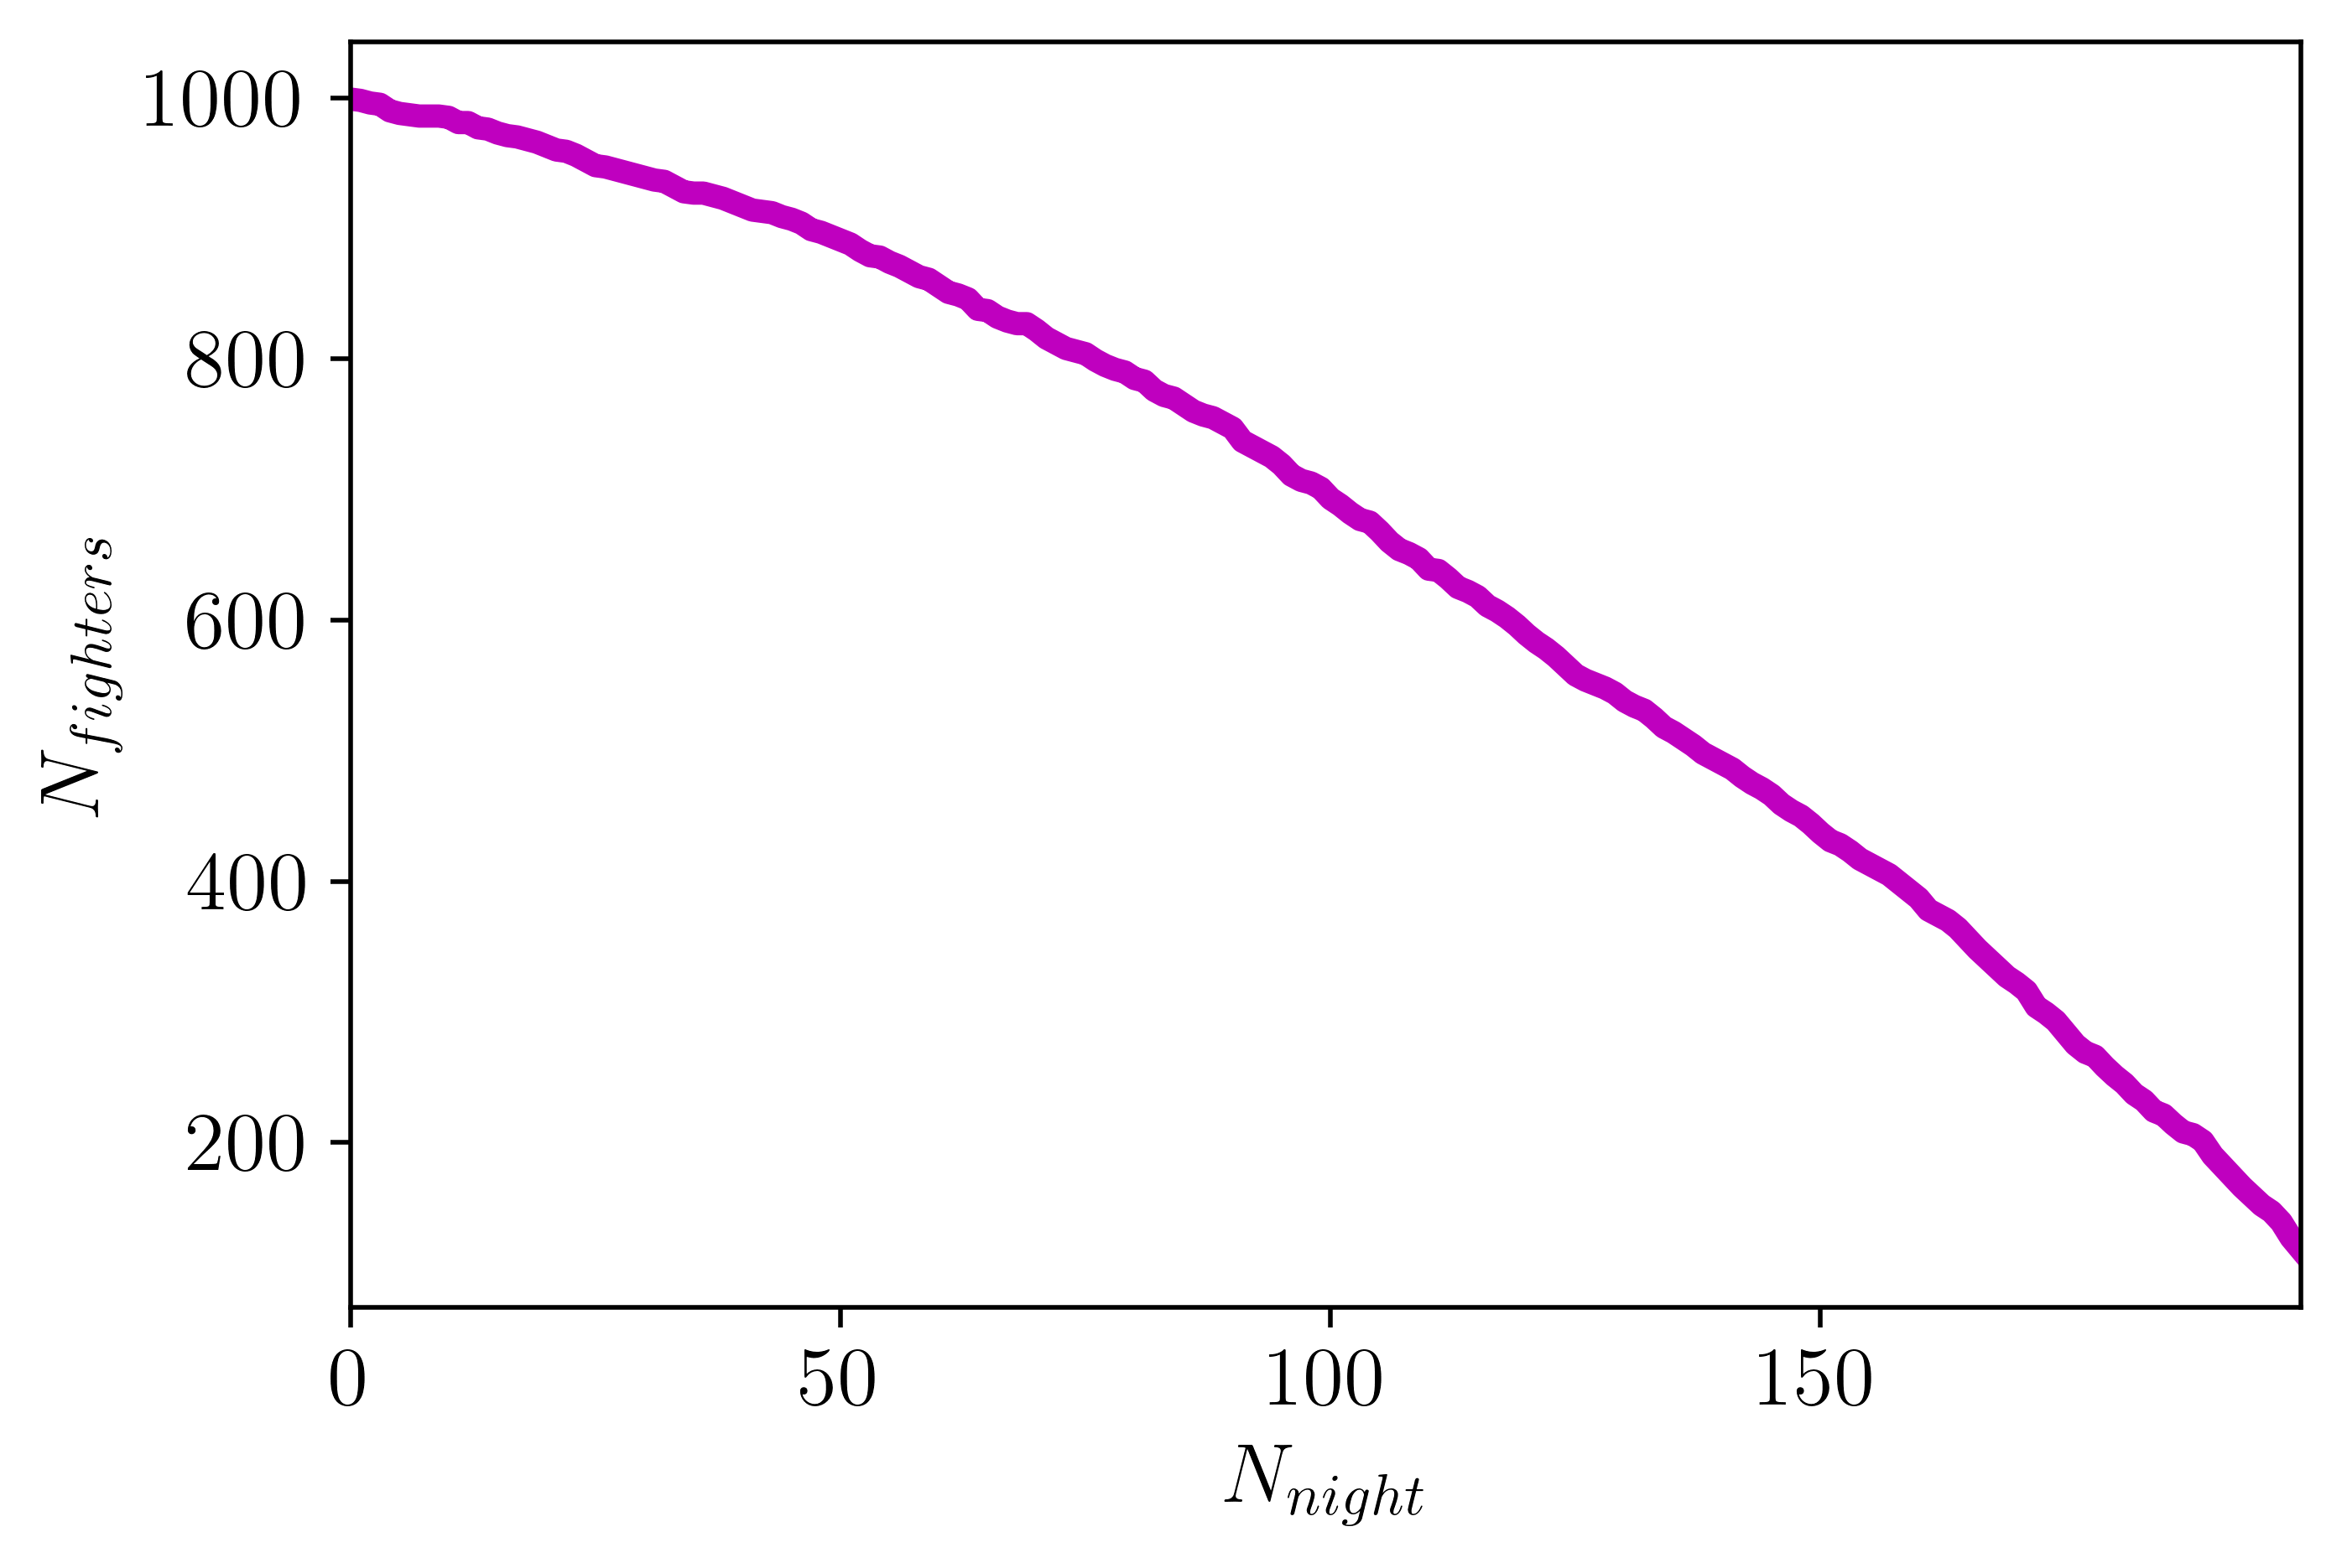
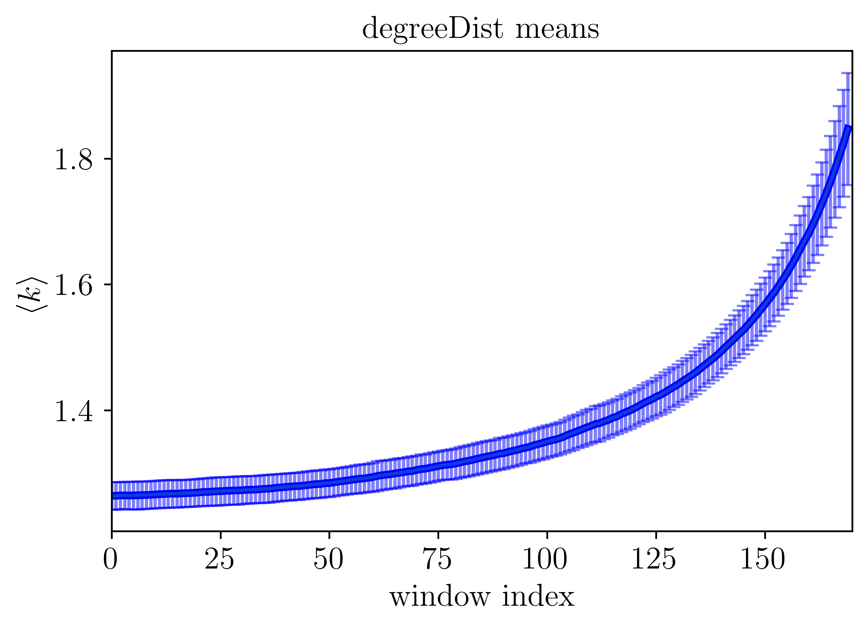
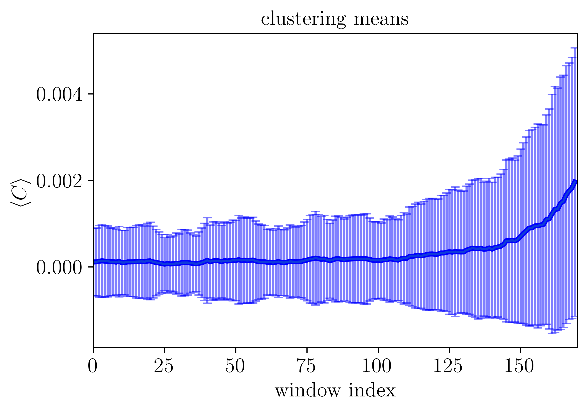
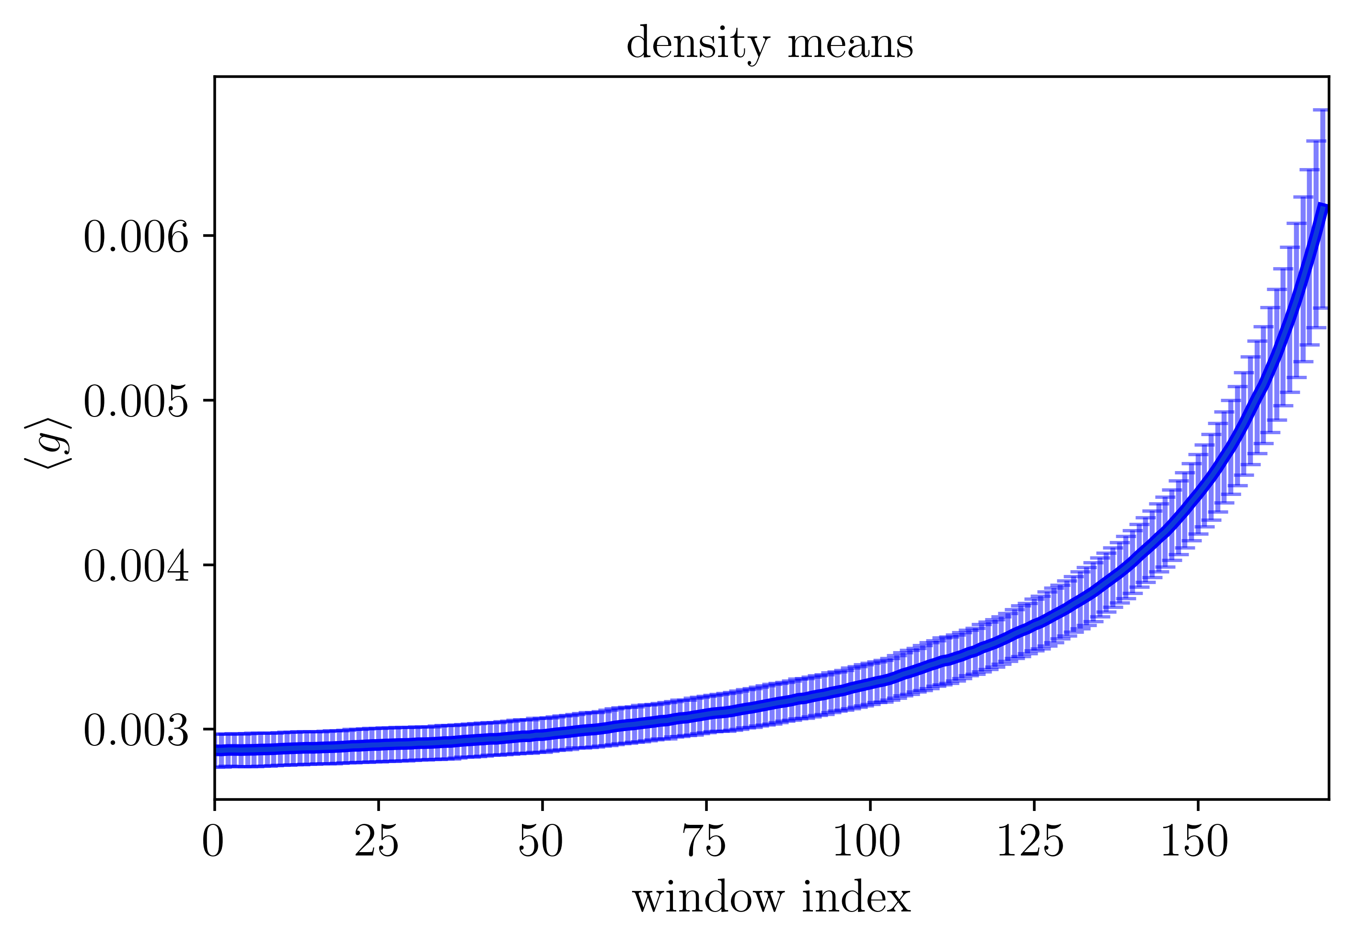
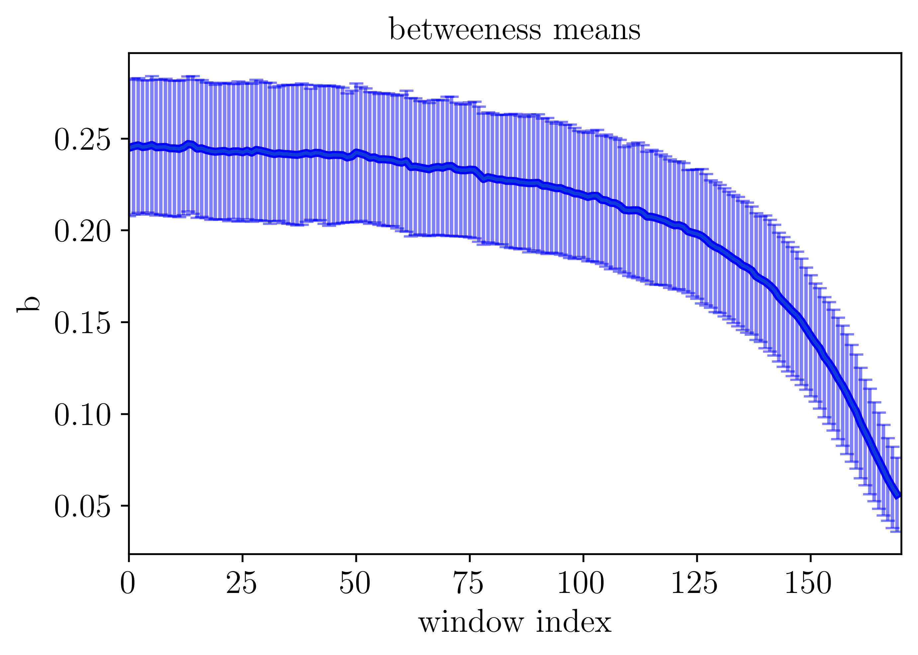
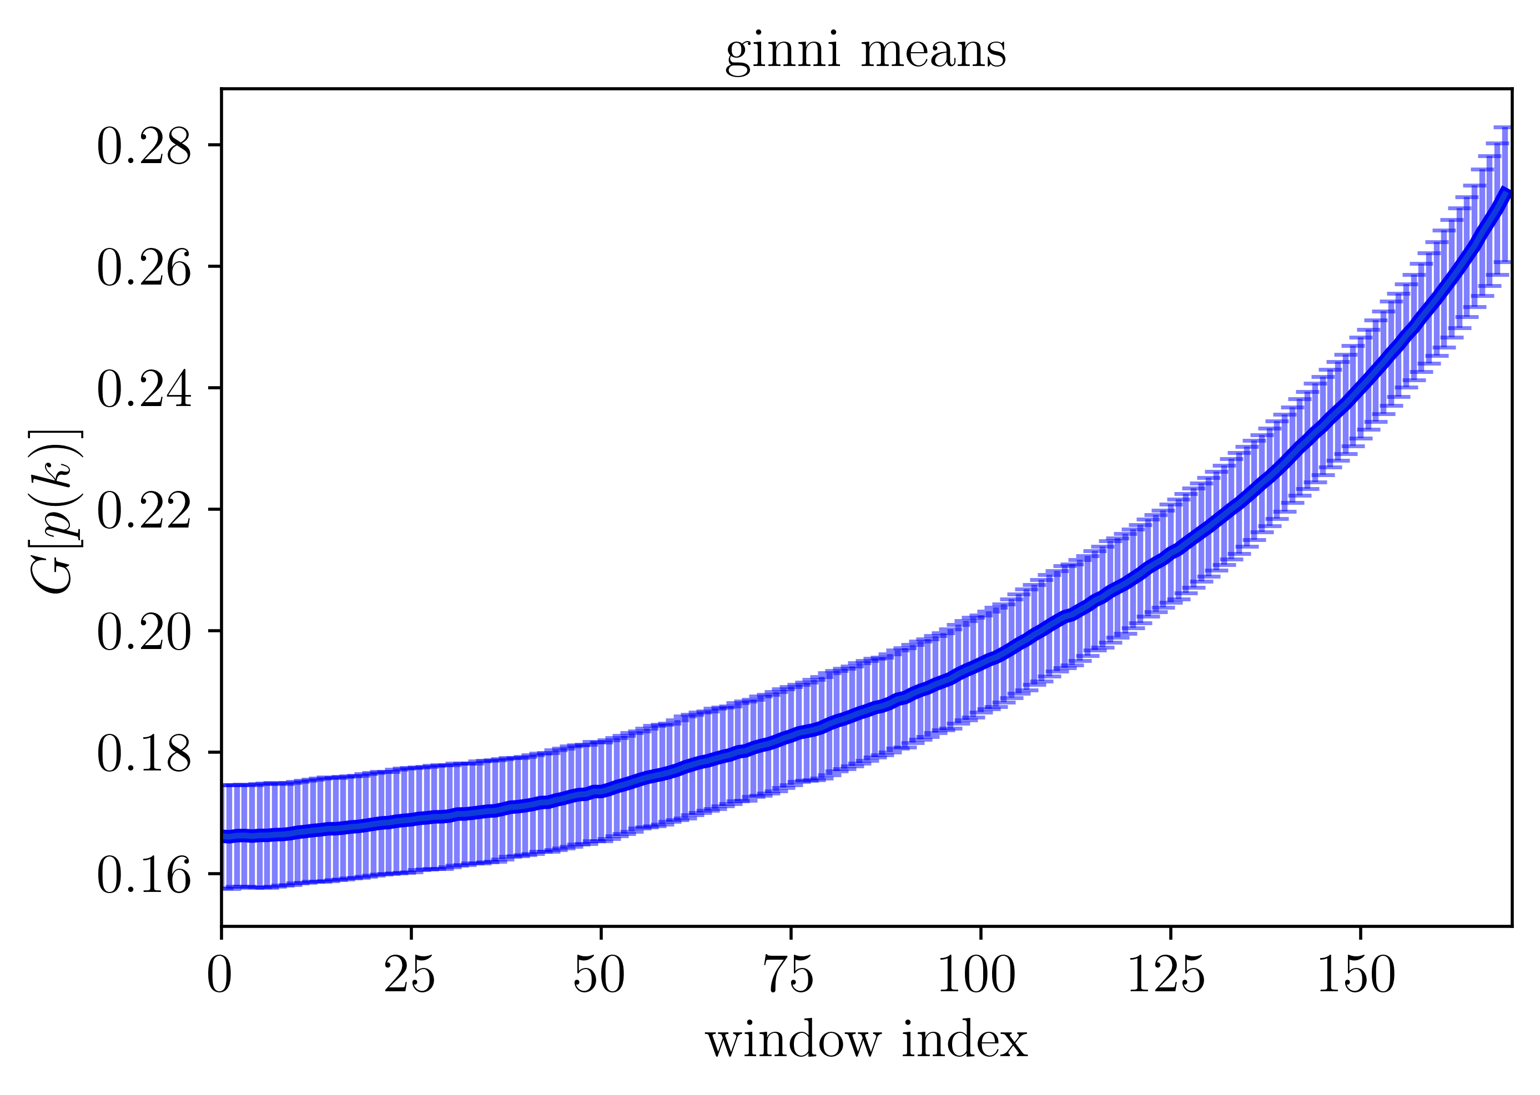
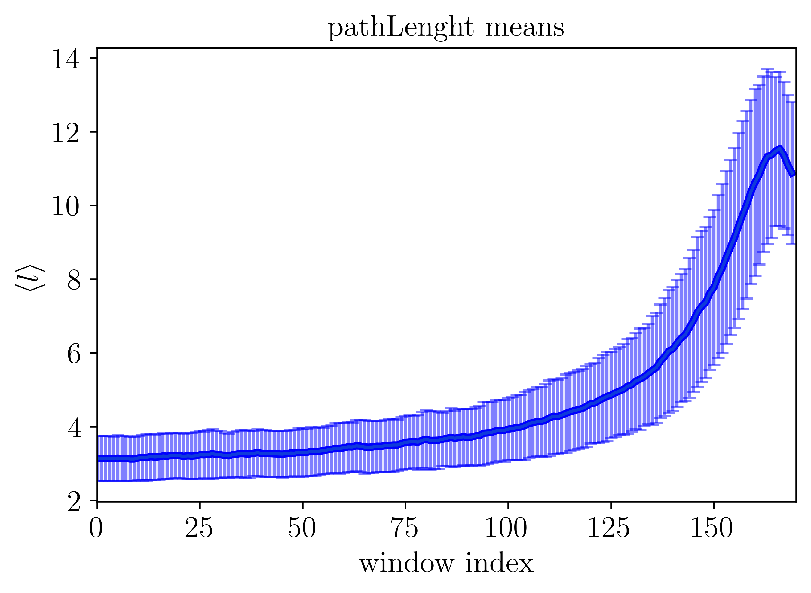
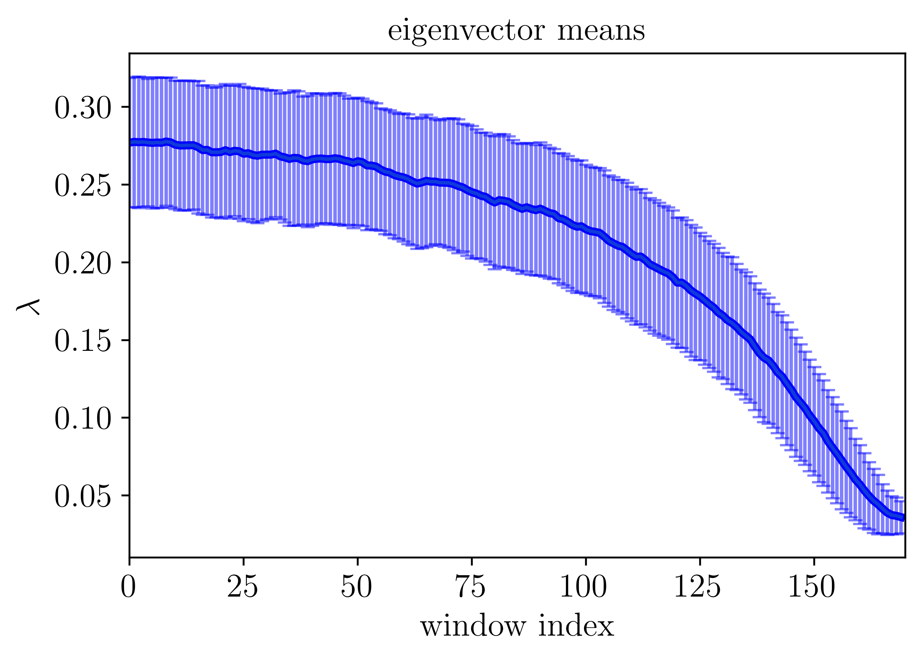
Simulation 1: no node aggregation

Slide 22
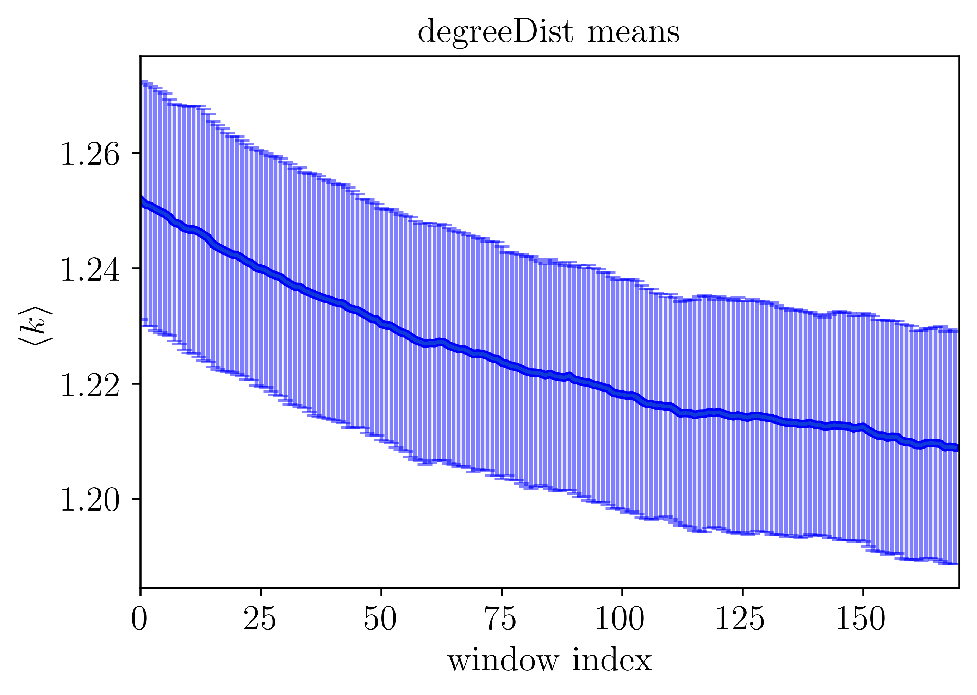
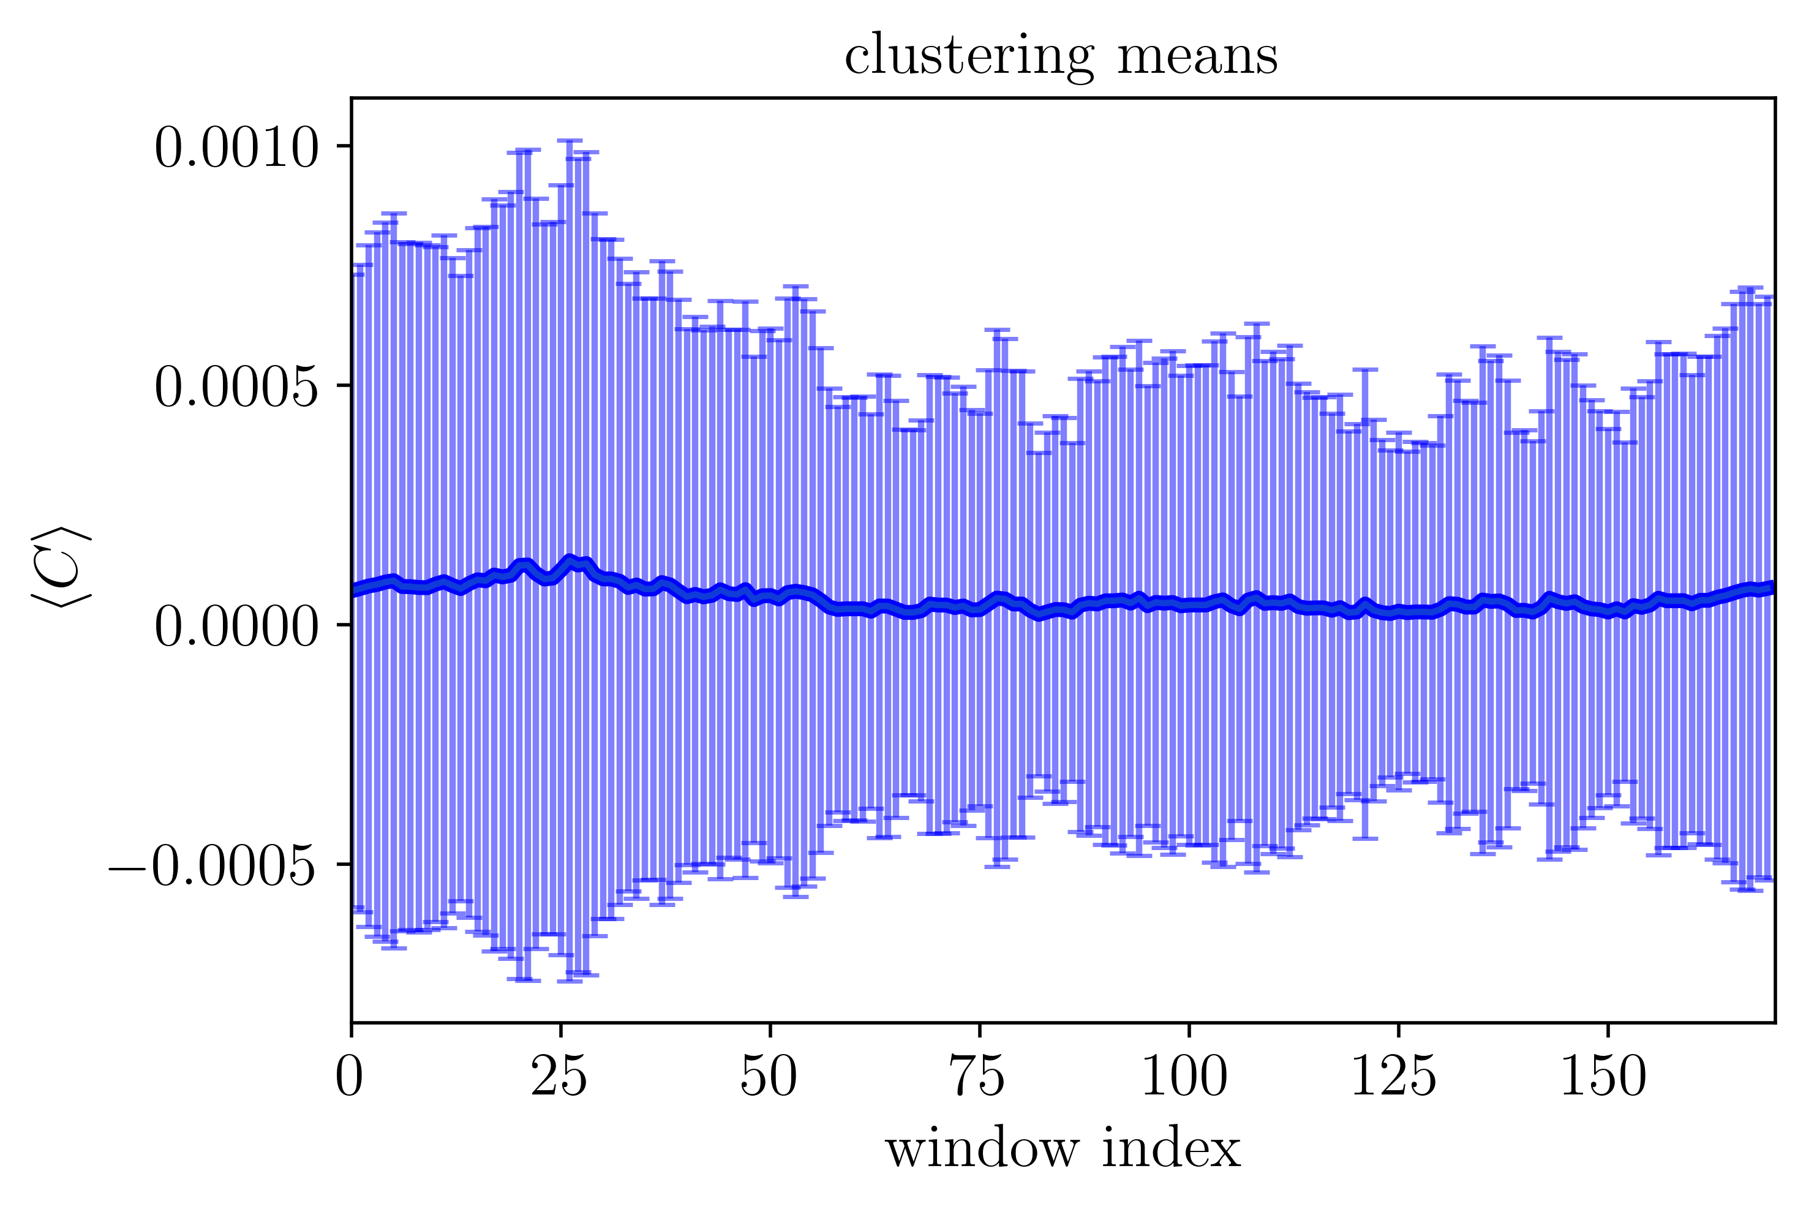
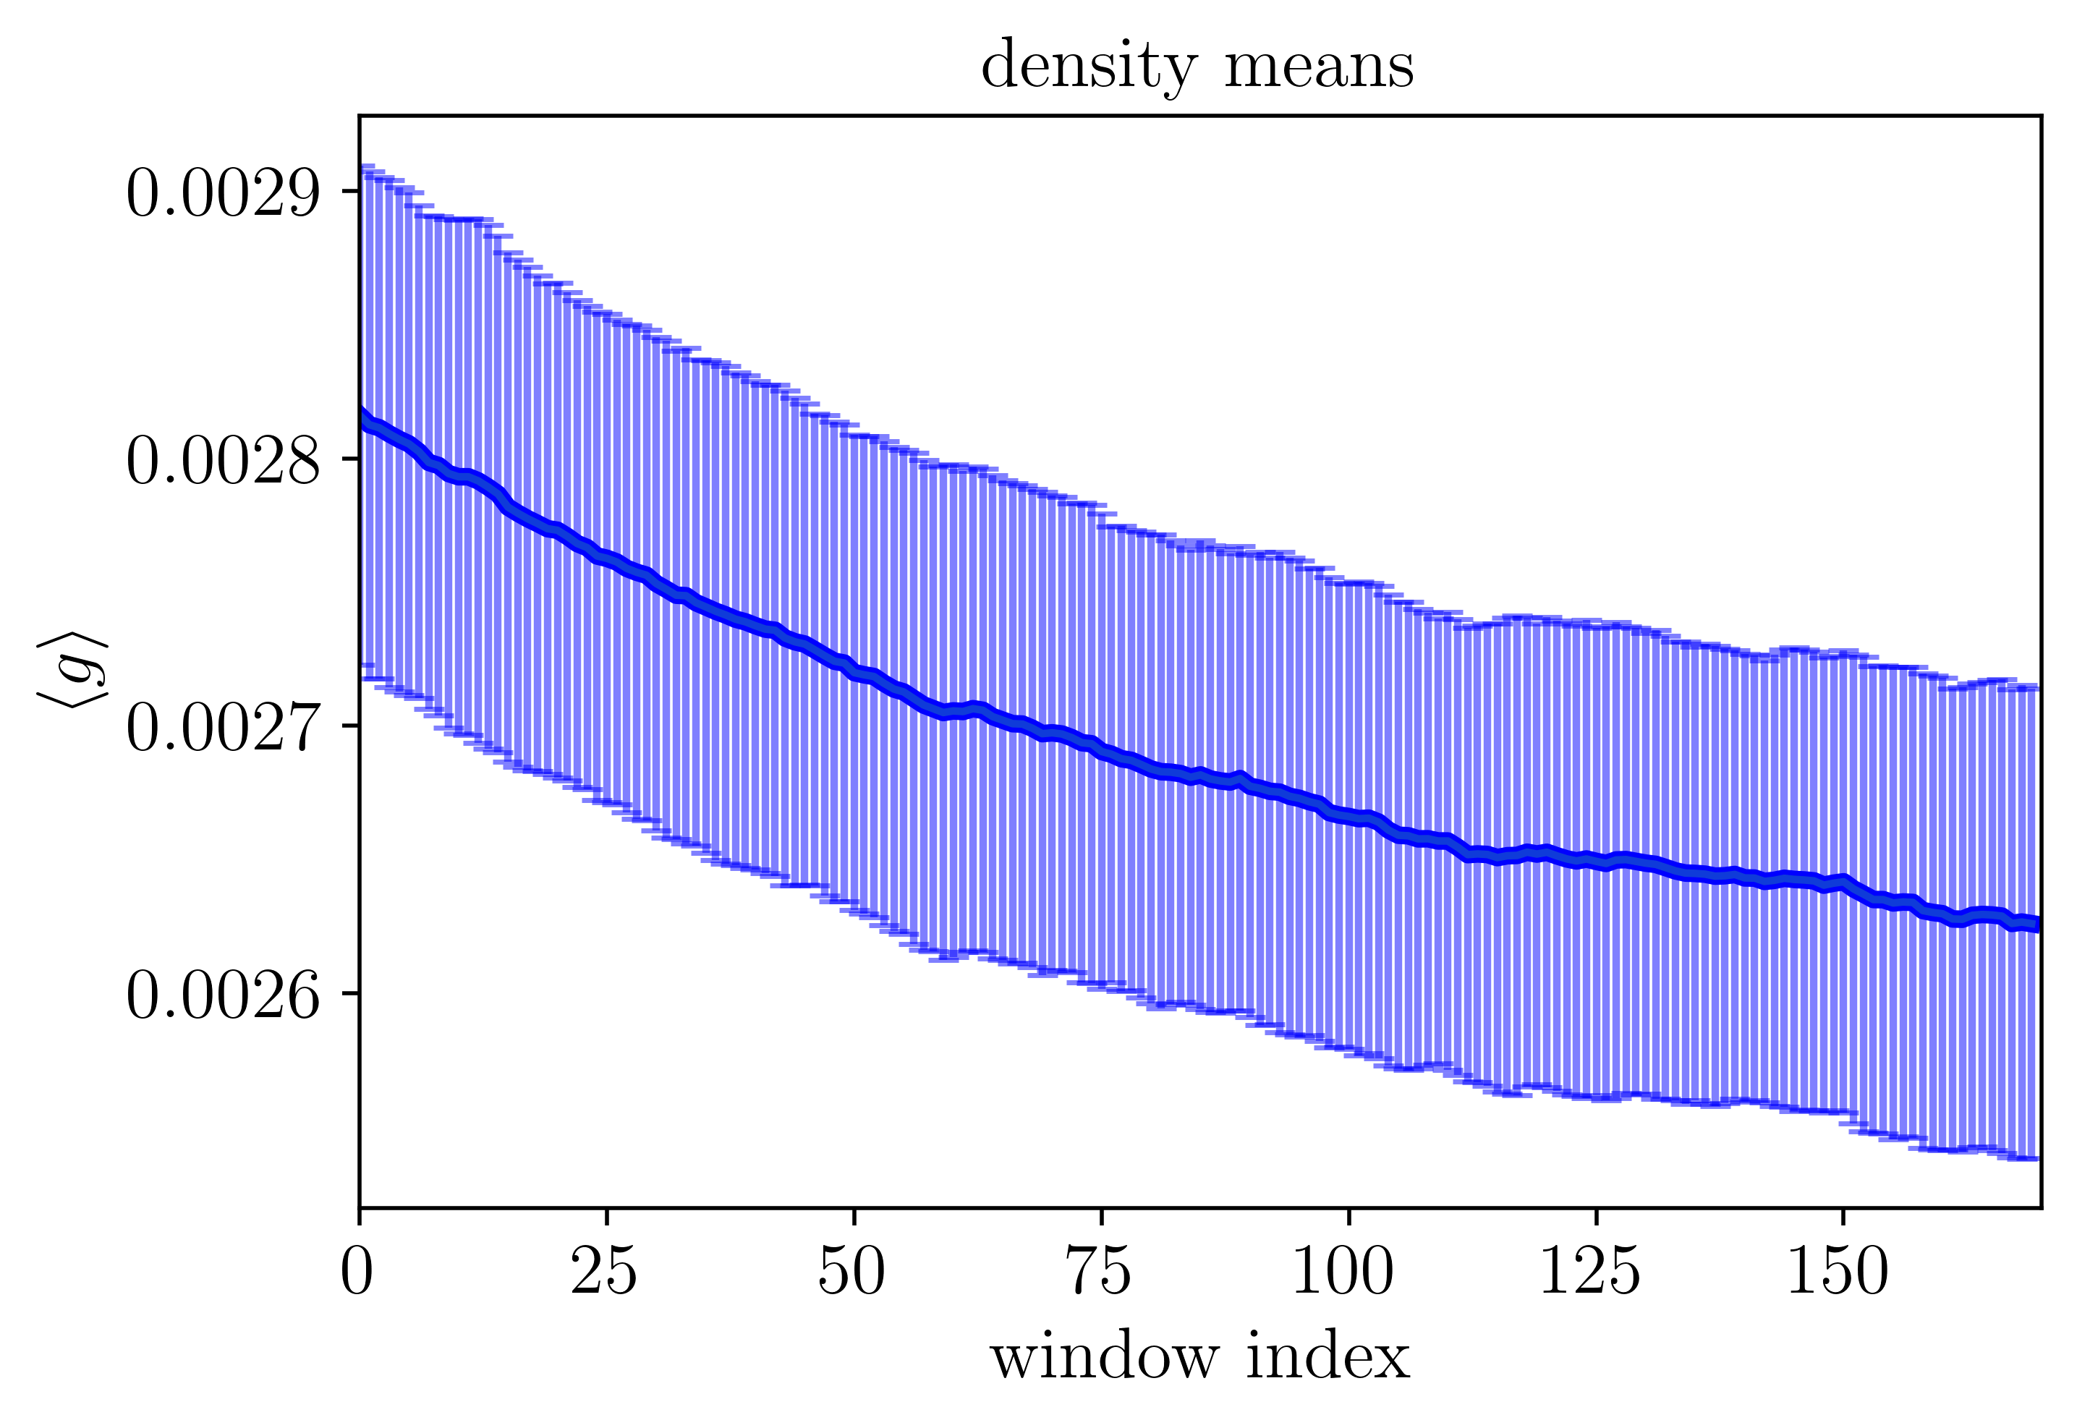
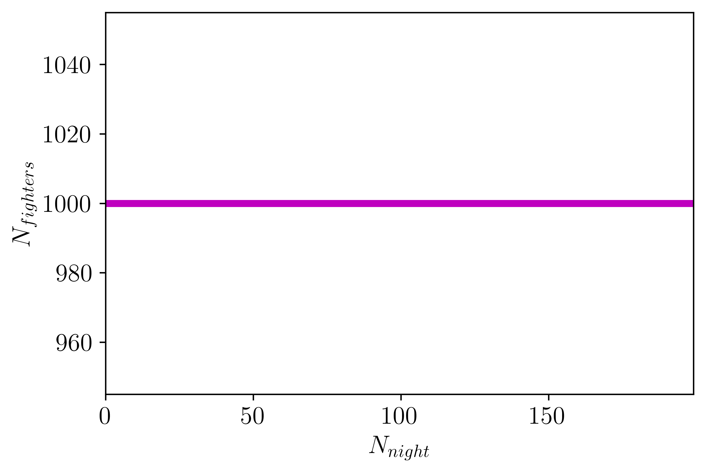
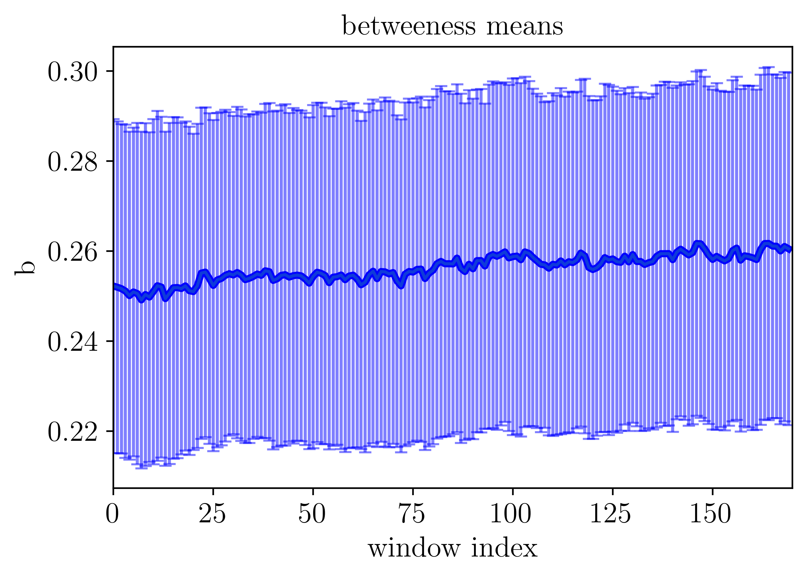
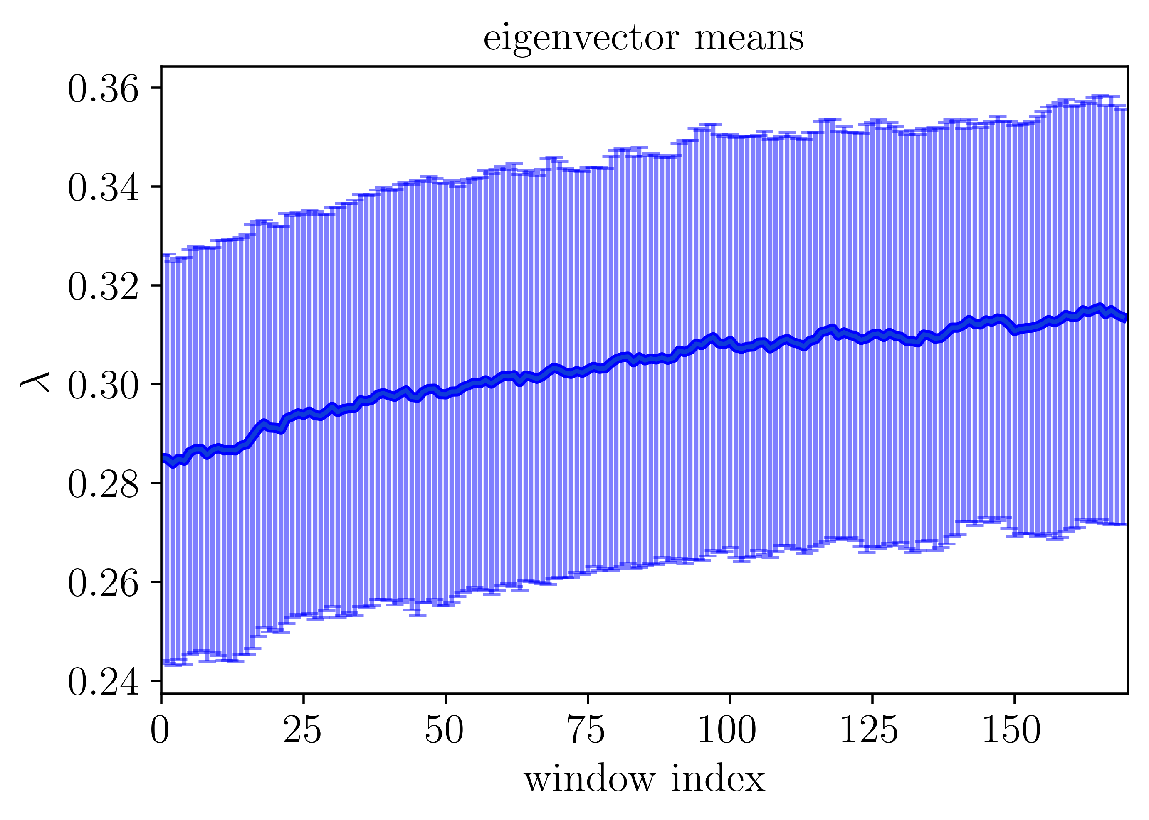
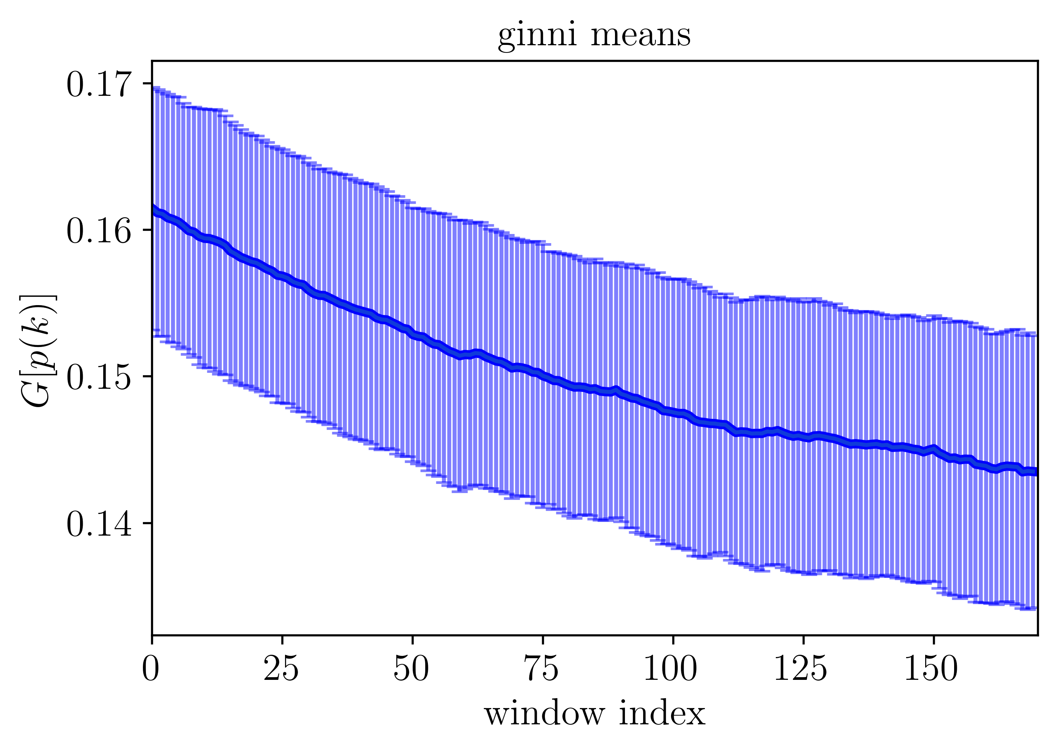
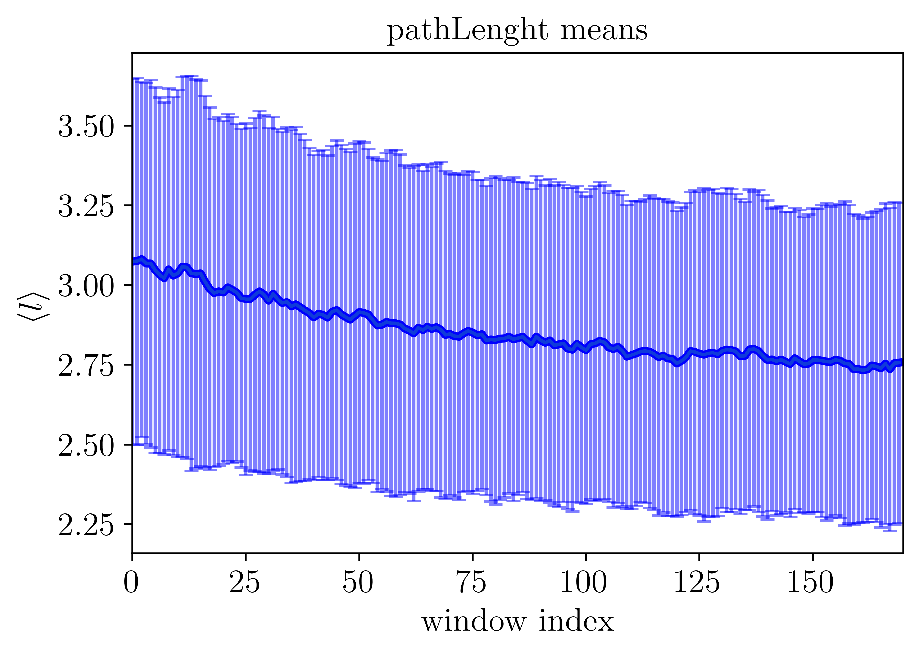
Simulation 2: constant number

Slide 23
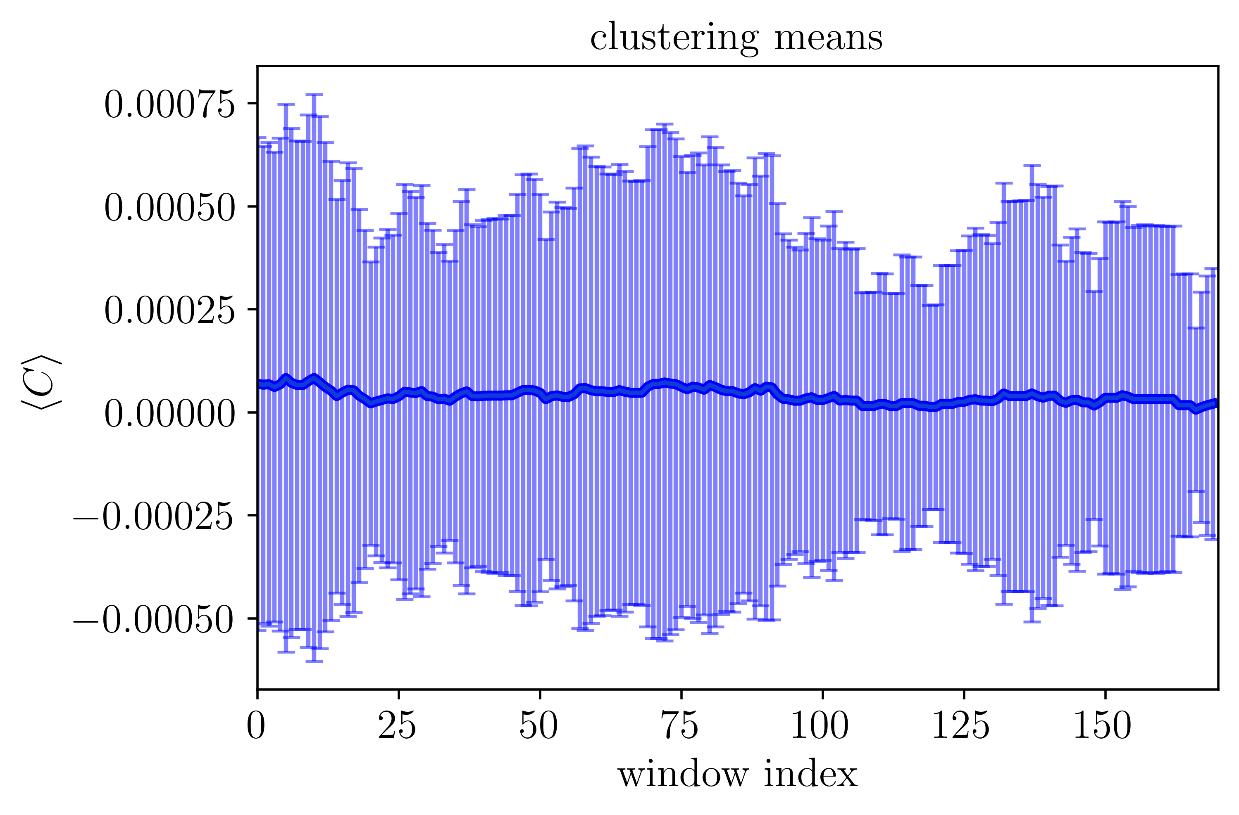
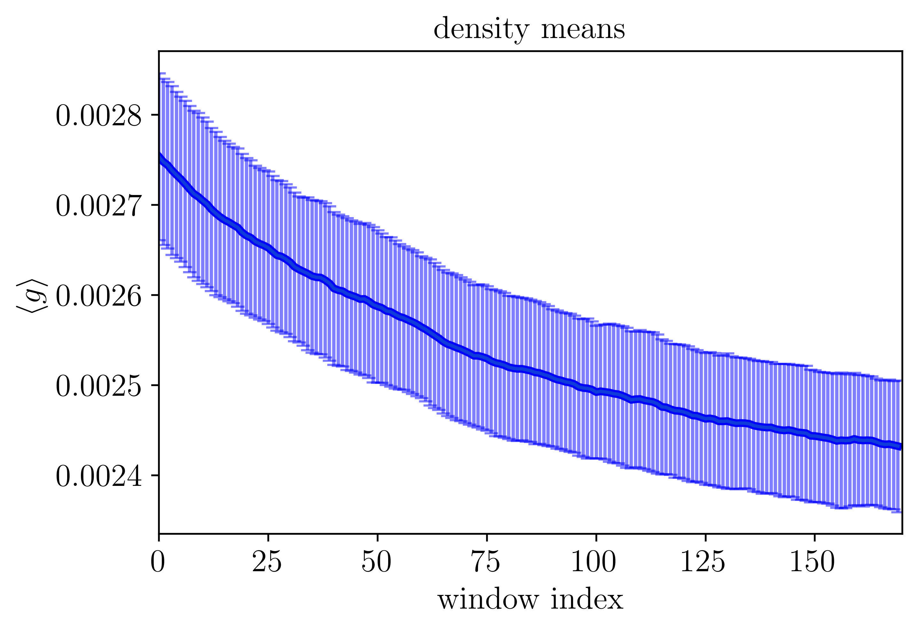
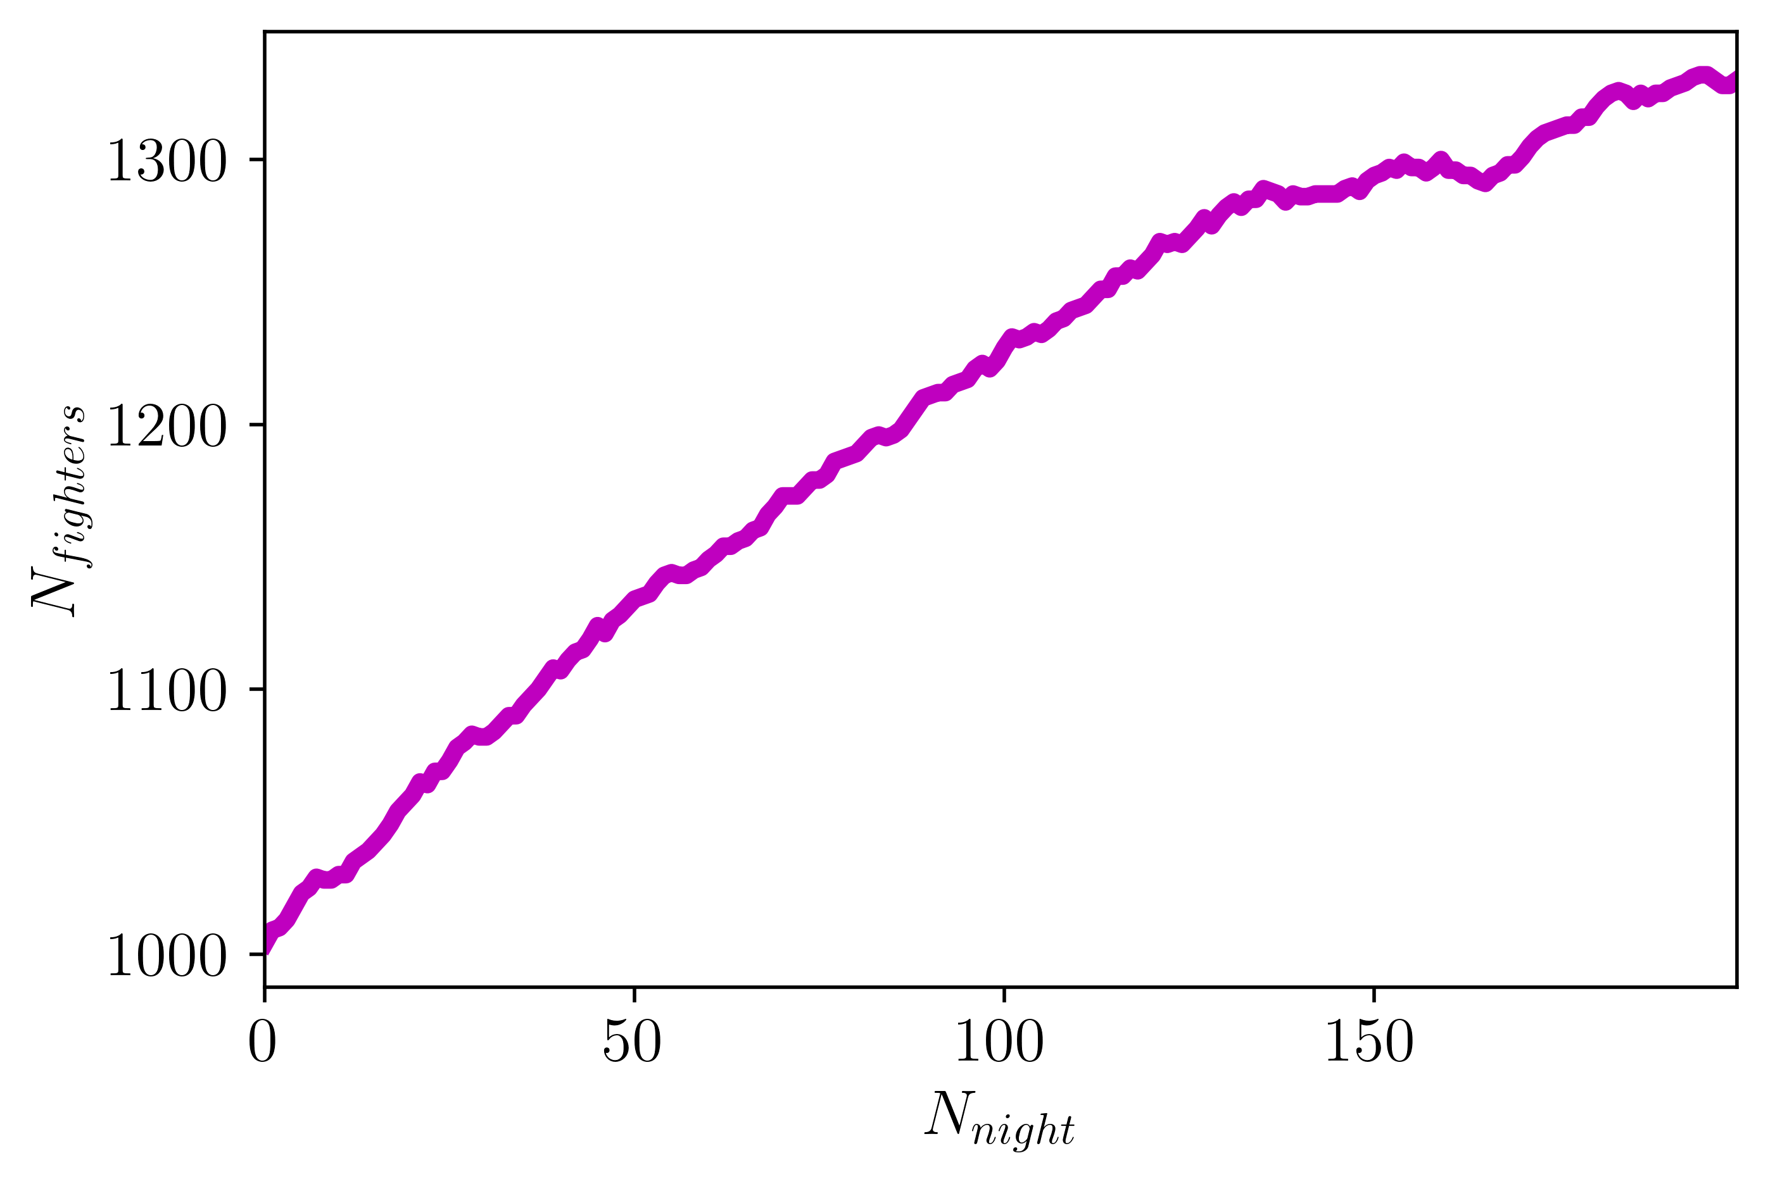
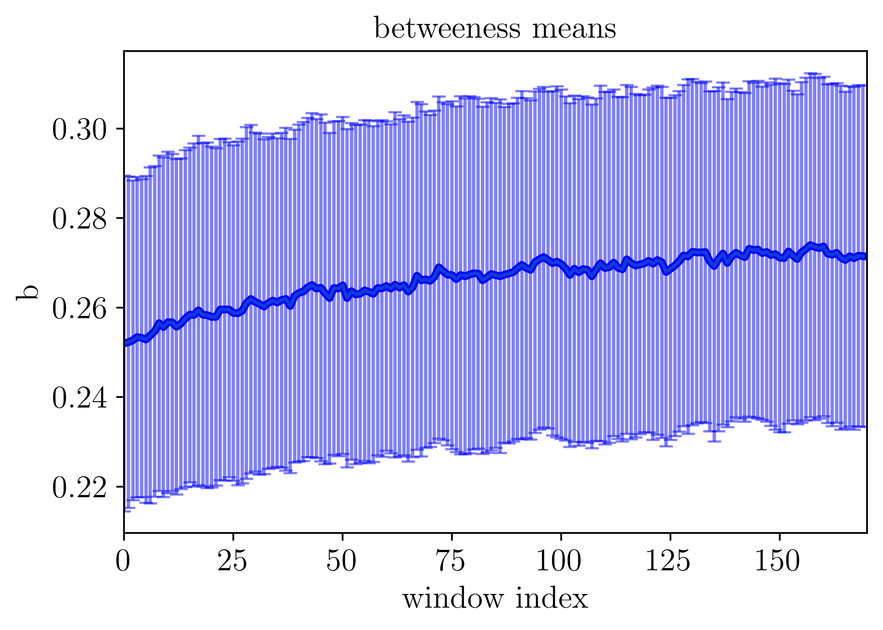
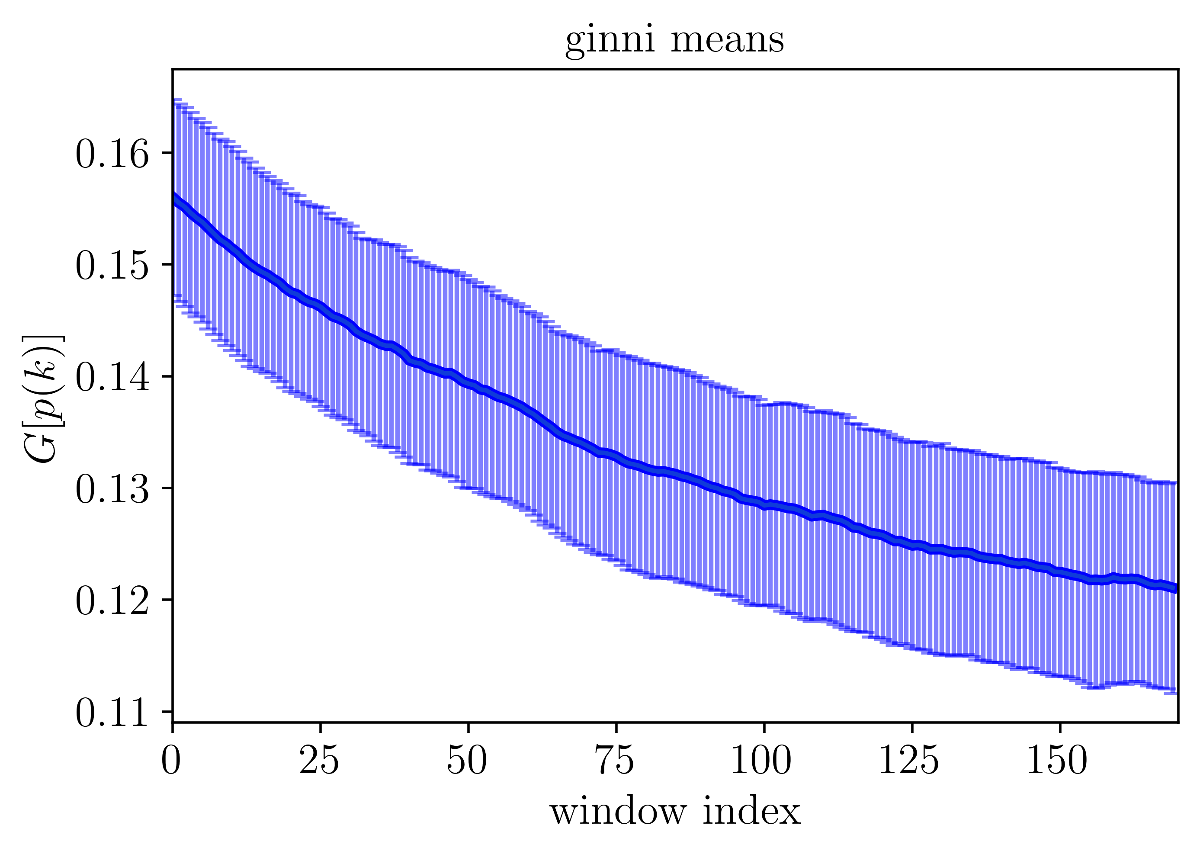


Simulation 3: node aggregation fixed N=5

Slide 24
Simulation 3: node aggregation fixed N=5

Slide 25

Gracias por su atención!

Slide 26



